Slide 1
Relational Database Implementation and Applications
Date of Presentation: 8/23/2023

Slide 2
Lesson 4:
Indexing and Hashing
Gerald Balekaki

Slide 3
Definition: Indexing
Indexing mechanisms used to speed up access to desired data using data structure known as ‘index’
An index can be an attribute or set of attributes, also called search key used to look up records in a file.
E.g., {SID} to look up student table or {SID,PID} in professor and student table.
An index file consists of entries/records <search-key: pointer>, much smaller than original file.
Ordered index: search keys are stored in a sorted order
Hash index: uses hash function to distributed search keys uniformly across “buckets”
Notes:
A hash function is a mathematical function that converts input data into a fixed-size string of characters, typically for data verification or indexing purposes.

Slide 4
Primary and Secondary indexes
Primary index (assume is sequentially ordered),
Is the index whose search key specifies the sequential order of the file (also, clustering index)
The search key of a primary index is usually but not necessarily the primary
Secondary index:
Is an index whose search key specifies an order different from the sequential order of the file (also non-clustering).
A sequentially ordered file with primary index is called an index-sequential file.
Sored index file
Sored record file (search-key)
Sored index file
Different order from index file
10
20
30
40
10
20
10
20
30
40
40
30
30
40
20
10
Notes:
A hash function is a mathematical function that converts input data into a fixed-size string of characters, typically for data verification or indexing purposes.

Slide 5
Primary and Secondary indexes …cont’d
Indexes are associated with overheads on the database
During an update on the database -- when a file is modified, every index on the file must be updated.
A sequential scan using primary index is efficient, but not for a secondary index
In a secondary index, every record accessed may fetch a new block from disk, thus expensive due to frequent reads.
Each block fetched requires about 5 to 10 milliseconds, versus about 100 nanoseconds for memory access (Silberschatz, Korth and Sudarshan, 2020)
Notes:
A hash function is a mathematical function that converts input data into a fixed-size string of characters, typically for data verification or indexing purposes.

Slide 6
Multilevel index
If primary index does not fit in memory, access becomes expensive.
Solution: treat primary index kept on disk as a sequential file and construct a sparse index on it.
outer index – a sparse index of primary index
inner index – the primary index file
If even outer index is too large to fit in main memory, yet another level of index can be created, and so on.
Indices at all levels must be updated on insertion or deletion from the file.
Notes:
A hash function is a mathematical function that converts input data into a fixed-size string of characters, typically for data verification or indexing purposes.

Slide 7
Index update: Single-level index Insertion
Perform a lookup using the search-key value appearing in the record to be inserted.
Dense indices – if the search-key value does not appear in the index, insert it.
Sparse indices – if index stores an entry for each block of the file, no change needs to be made to the index unless a new block is created.
If a new block is created, the first search-key value appearing in the new block is inserted into the index.
Notes:
A hash function is a mathematical function that converts input data into a fixed-size string of characters, typically for data verification or indexing purposes.

Slide 8
Index update: single-level index deletion
Dense indices – deletion of search-key is similar to file record deletion.
Sparse indices –
if an entry for the search key exists in the index, it is deleted by replacing the entry in the index with the next search-key value in the file (in search-key order).
If the next search-key value already has an index entry, the entry is deleted instead of being replaced.
Notes:
A hash function is a mathematical function that converts input data into a fixed-size string of characters, typically for data verification or indexing purposes.

Slide 9
B+ tree index
B+-Tree is a self-balancing tree data structure that keeps data sorted and allows searches, sequential access, insertion, and deletions in O(log n) .
Generalization of a binary search tree in that a node can have more than two children.
Optimized for systems that read and write large blocks of data.
It is perfectly balanced (i.e., every leaf node is at the same depth from the root node in tree).
Notes:
A hash function is a mathematical function that converts input data into a fixed-size string of characters, typically for data verification or indexing purposes.

Slide 10
Properties of B+-trees
All paths from root to leaf are of the same length
Each node that is not a root or a leaf has between (n/2) and n children.
A leaf node has between (n–1)/2 and n–1 values
Special cases:
If the root is not a leaf, it has at least 2 children.
If the root is a leaf (that is, there are no other nodes in the tree), it can have between 0 and (n–1) values.
Notes:
A hash function is a mathematical function that converts input data into a fixed-size string of characters, typically for data verification or indexing purposes.

Slide 11
Example of a B+ tree
Each node is stored in one block on disk
Root node: the node at the “top” of the tree
Inner/Internal/intermediate node: a node that has one or more child node(s)
Leaf node: a node that does not have any children nodes
Notes:
A hash function is a mathematical function that converts input data into a fixed-size string of characters, typically for data verification or indexing purposes.

Slide 12
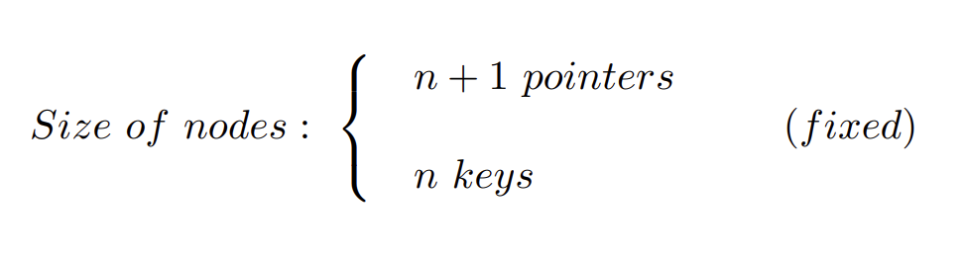
Size of B+ tree nodes
Each internal node is stored in one block on disk
and contains at most n keys and (n+1) pointers
Notes:
A hash function is a mathematical function that converts input data into a fixed-size string of characters, typically for data verification or indexing purposes.

Slide 13
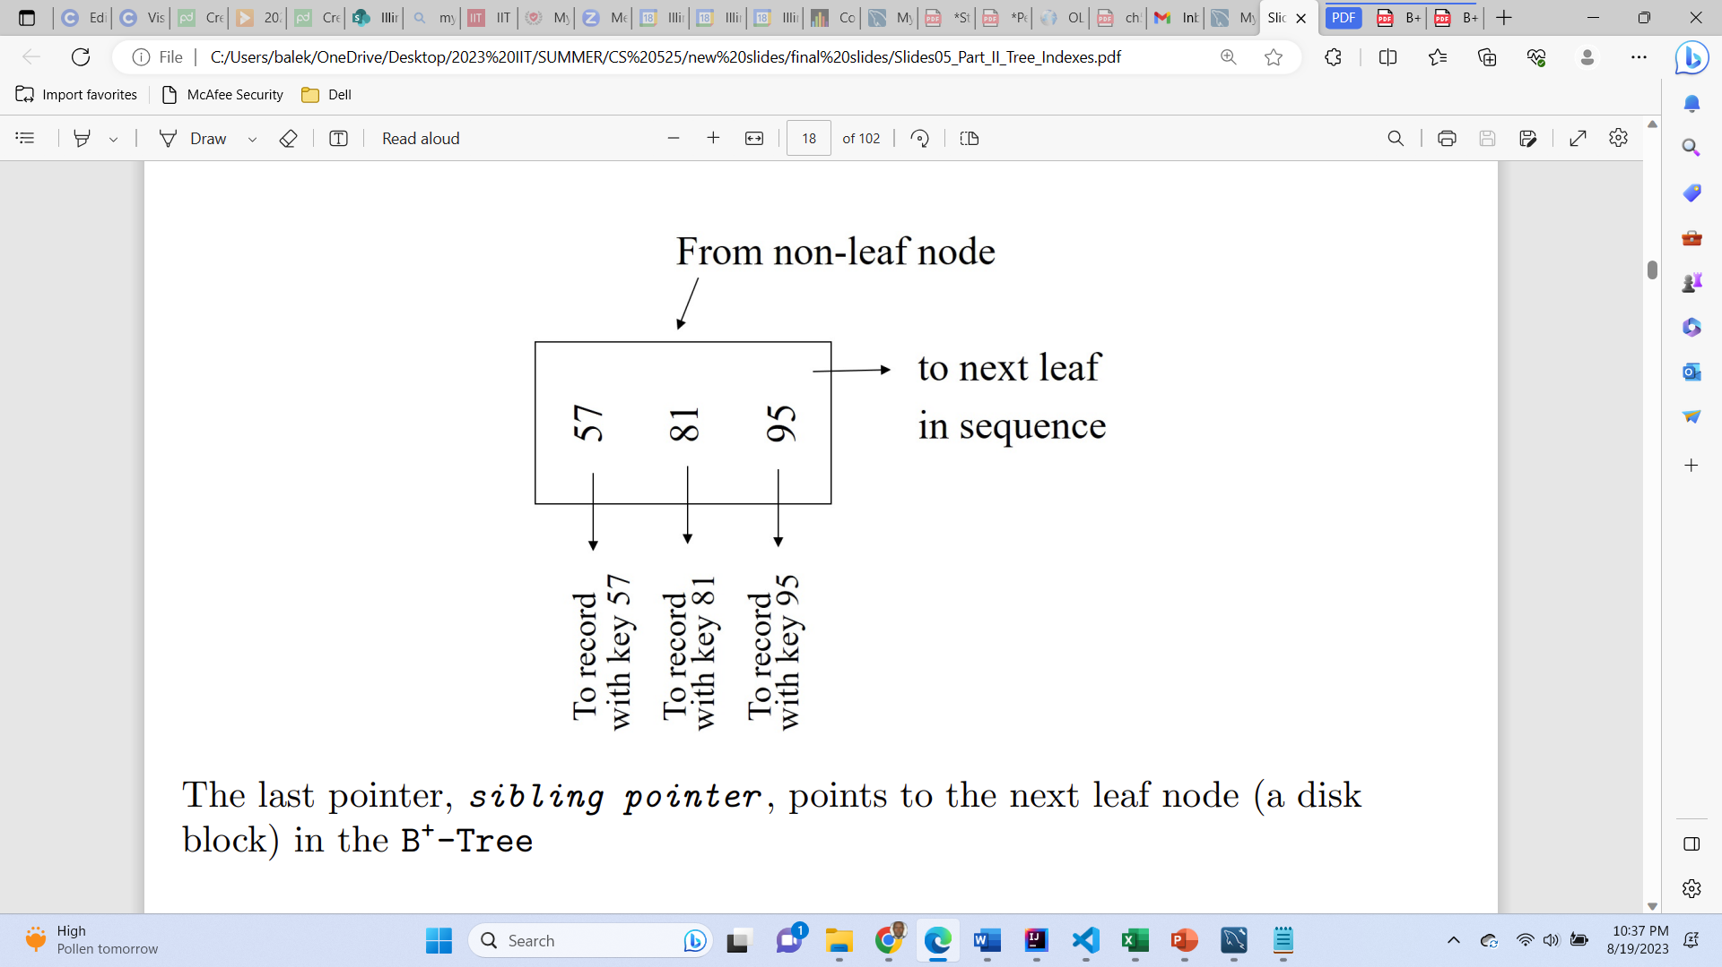
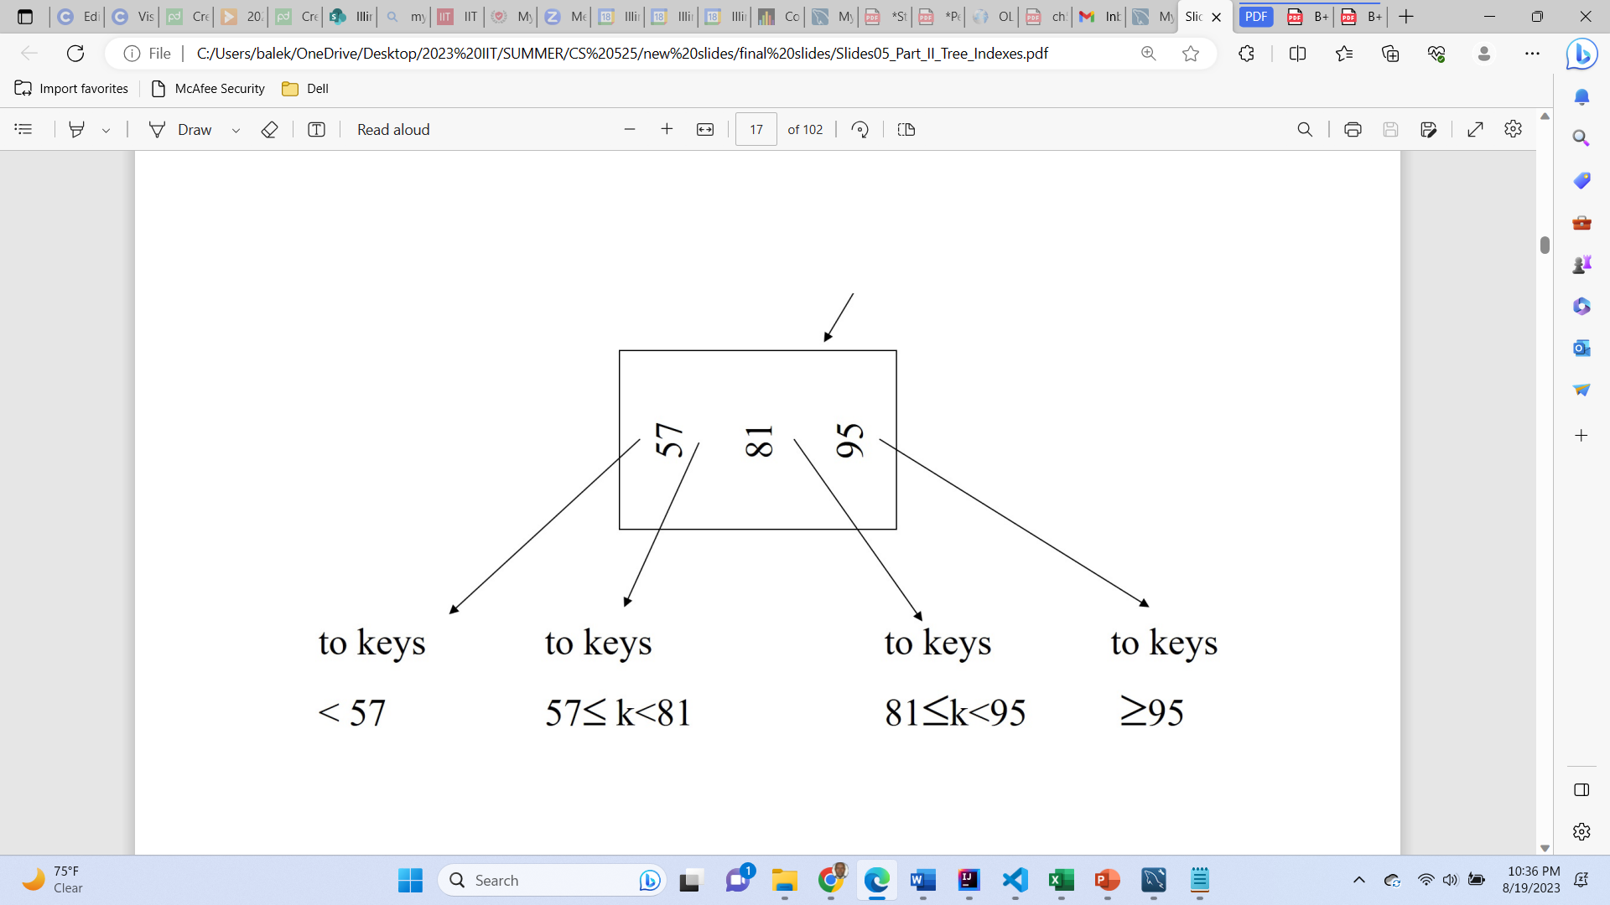
Example: B+ tree structure with n=3
From non-leaf node
Leaf node
Non-Leaf node
Notes:
A hash function is a mathematical function that converts input data into a fixed-size string of characters, typically for data verification or indexing purposes.

Slide 14
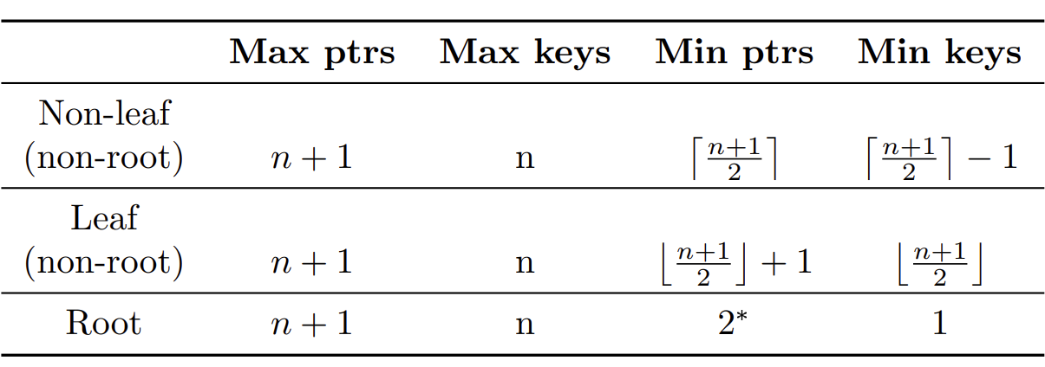
B+ tree no. of pointers and keys
Use a “Fill Factor” to control the growth and the shrinkage.
A 50% fill factor would be the minimum for B+-Tree
Use at least (to ensure a balanced tree)
Non-leaf: (n+1)/2 pointers (to nodes)
Except root: required at least 2 be used
Leaf: (n+1)/2 pointers (to data)
2* -- If there is one record in the leaf node, min pointer at the root is be 1
Notes:
A hash function is a mathematical function that converts input data into a fixed-size string of characters, typically for data verification or indexing purposes.

Slide 15
Search Algorithm [Find (k)]
Search for key k
Start from root until leaf is reached
For current node find i so that
Key[i] < k ≤ Key[i + 1]
Follow (i+1)th pointer
If current node is leaf, return pointer to record or fail (no such record in tree)
Notes:
A hash function is a mathematical function that converts input data into a fixed-size string of characters, typically for data verification or indexing purposes.

Slide 16
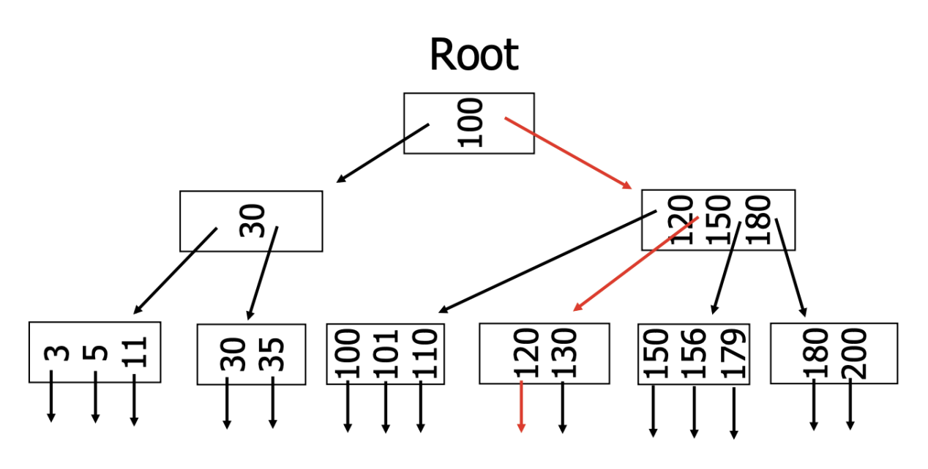
Find (k=120), n=3
Notes:
A hash function is a mathematical function that converts input data into a fixed-size string of characters, typically for data verification or indexing purposes.

Slide 17
B+ tree insertion

Slide 18
Insertion algorithm
To Insert Record with key k
Find correct leaf node L for k
Add new entry into L in sorted order:
If L has enough space, the operation done.
Otherwise
Split L into two nodes L and L1.
Redistribute entries evenly and copy up middle key (new leaf’s smallest key)
Insert index entry pointing to L1 into parent of L
To split an inner node, redistribute entries evenly, but push up the middle key.
Notes:
A hash function is a mathematical function that converts input data into a fixed-size string of characters, typically for data verification or indexing purposes.

Slide 19
Case: simple insert into B+ tree
Insert key = 32, n=3
Notes:
A hash function is a mathematical function that converts input data into a fixed-size string of characters, typically for data verification or indexing purposes.

Slide 20
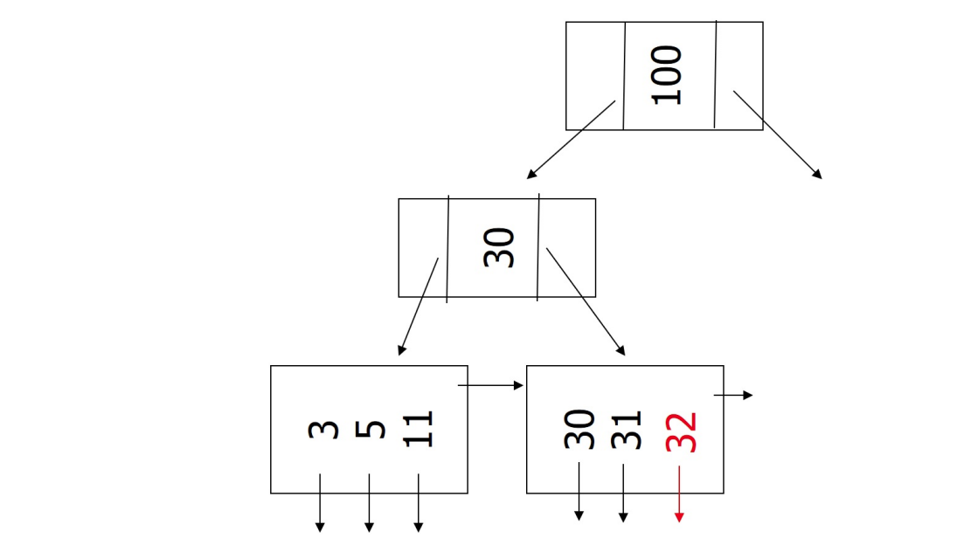
Simple case: insert into B+ tree
Insert key = 32, n=3
Notes:
A hash function is a mathematical function that converts input data into a fixed-size string of characters, typically for data verification or indexing purposes.

Slide 21
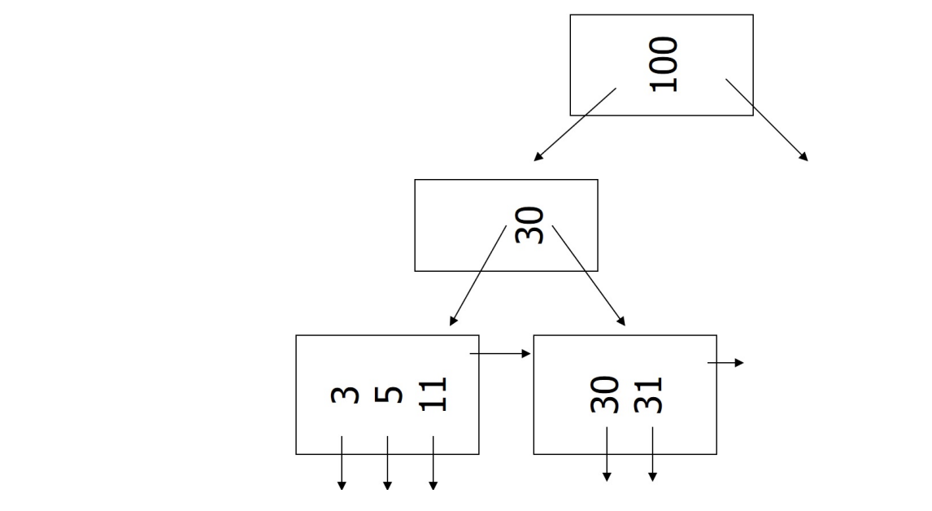
Case: leaf overflow - insert into B+ tree
Insert key =7, n=3
Notes:
A hash function is a mathematical function that converts input data into a fixed-size string of characters, typically for data verification or indexing purposes.

Slide 22
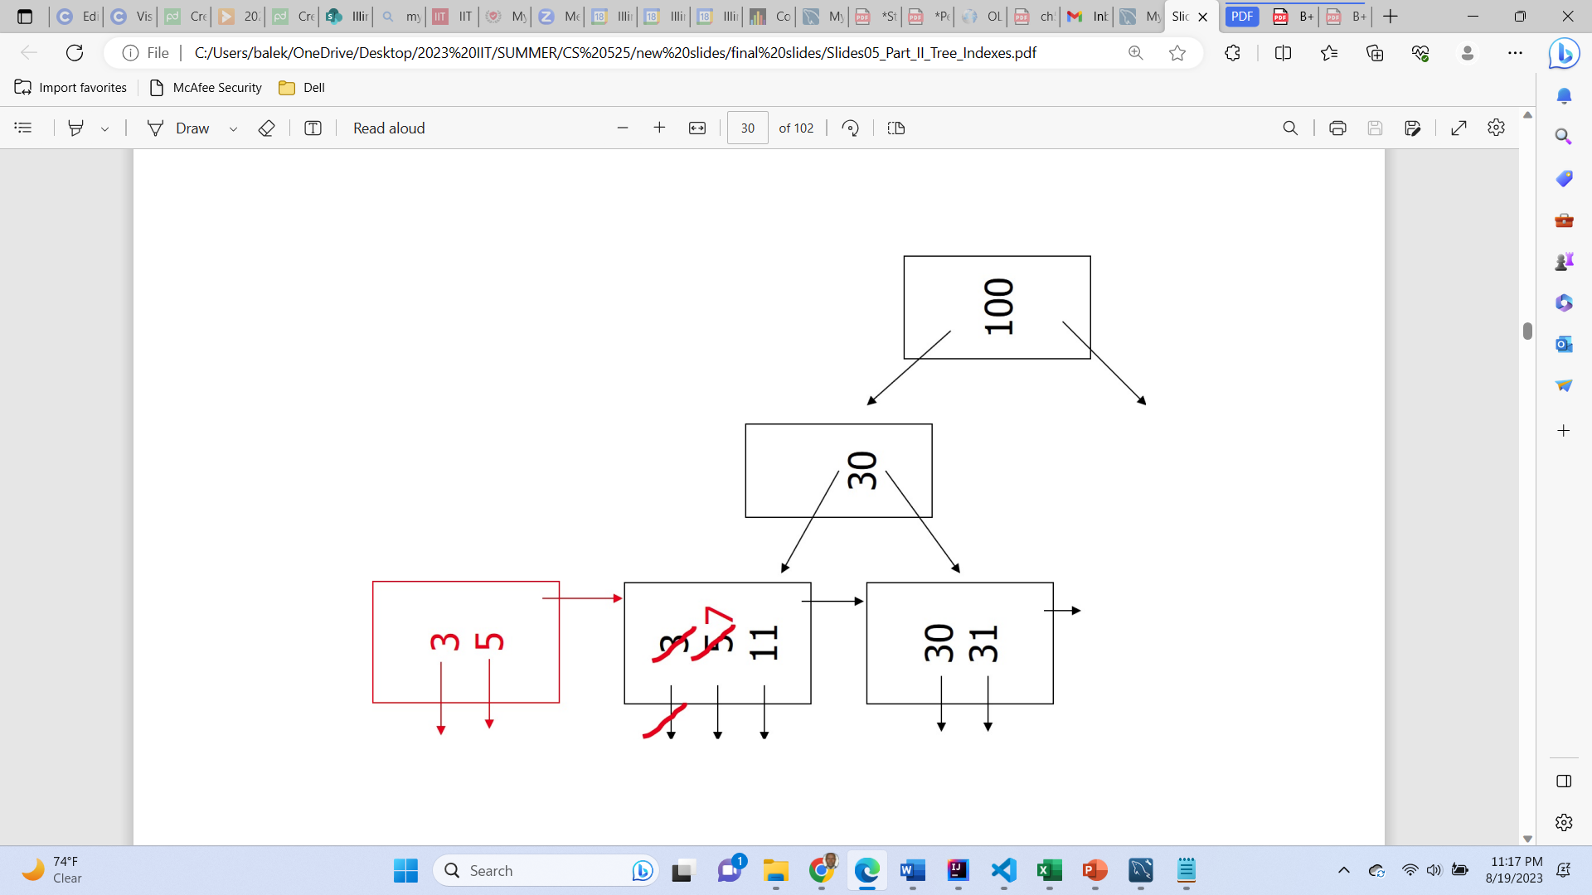
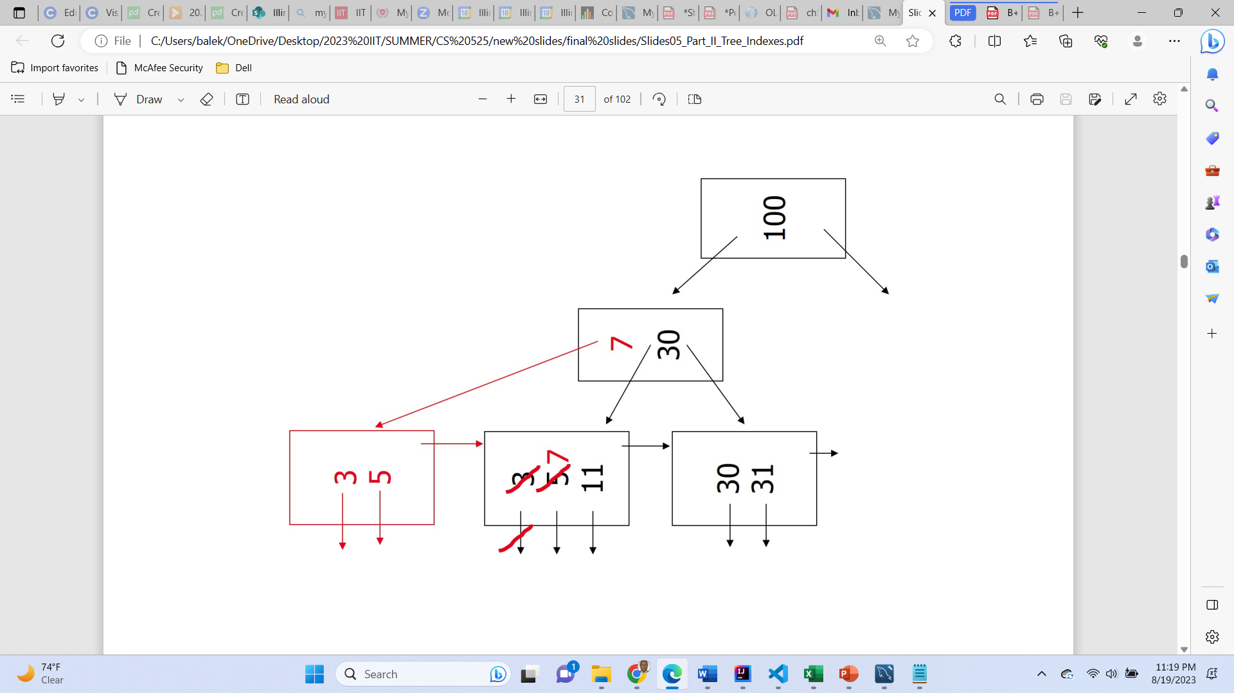
Case: leaf overflow - insert into B+ tree
Insert key =7, n=3
Notes:
A hash function is a mathematical function that converts input data into a fixed-size string of characters, typically for data verification or indexing purposes.

Slide 23
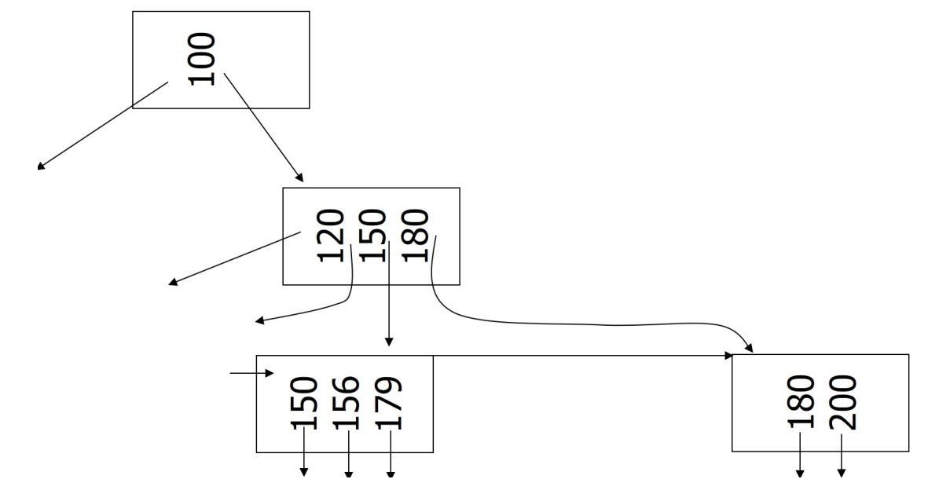
Case: Non-leaf overflow - insert into B+ tree
Insert key = 160, n=3
Notes:
A hash function is a mathematical function that converts input data into a fixed-size string of characters, typically for data verification or indexing purposes.

Slide 24
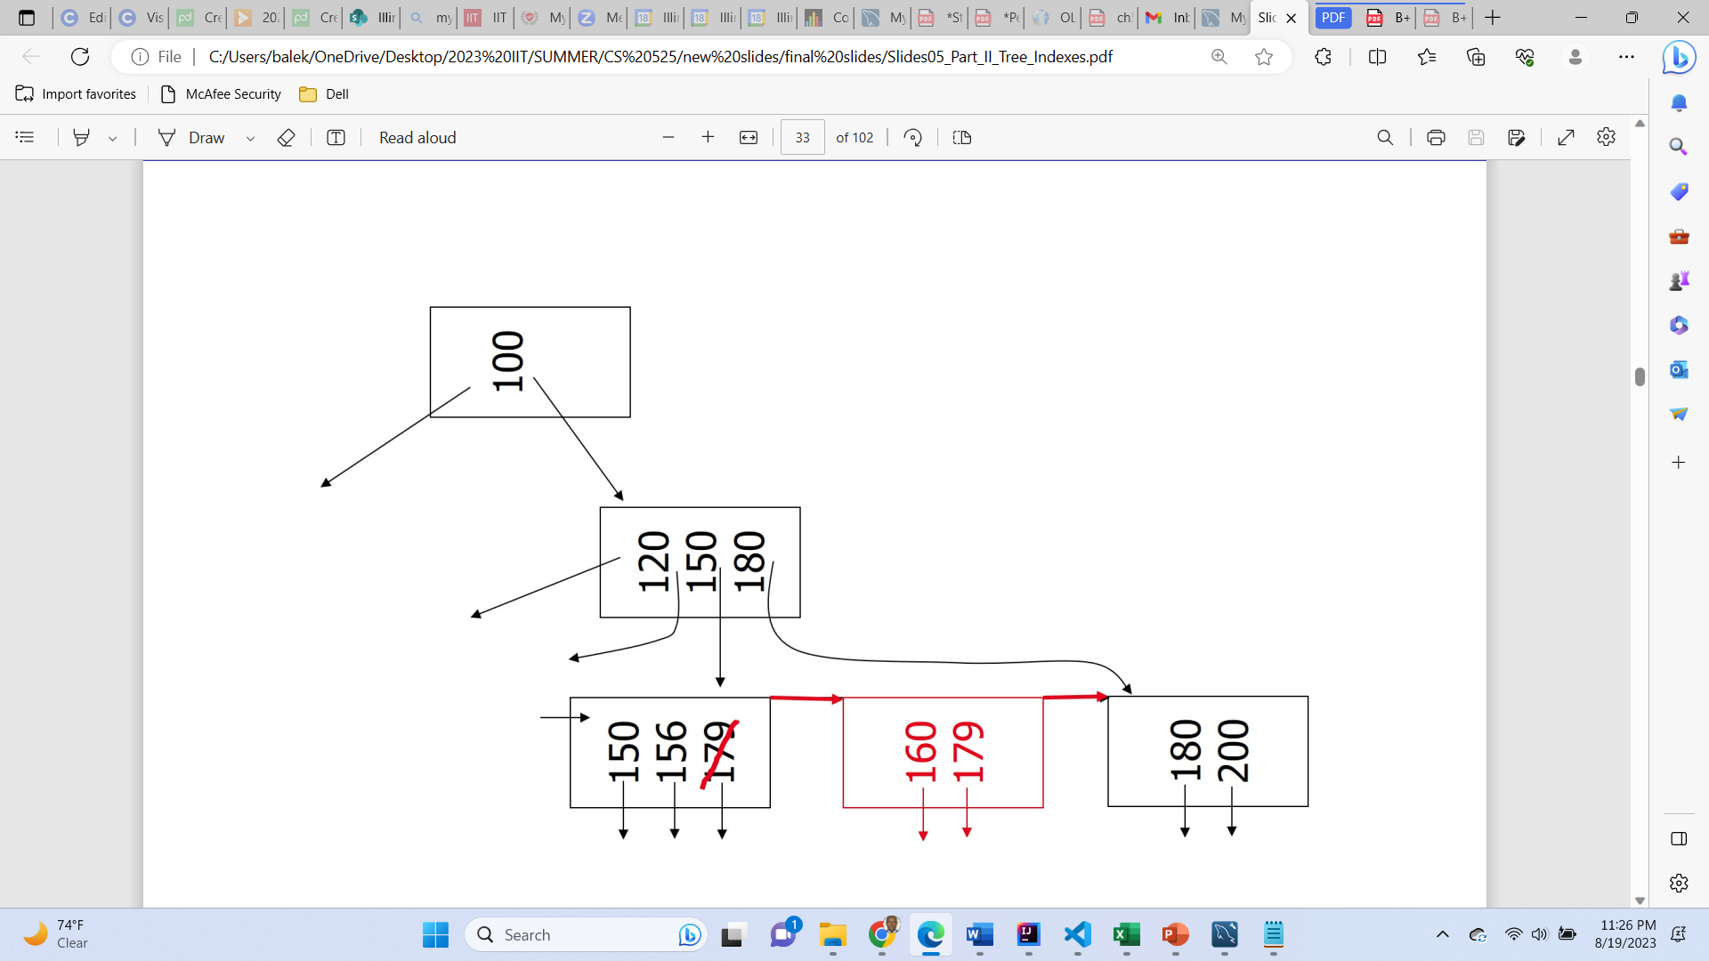
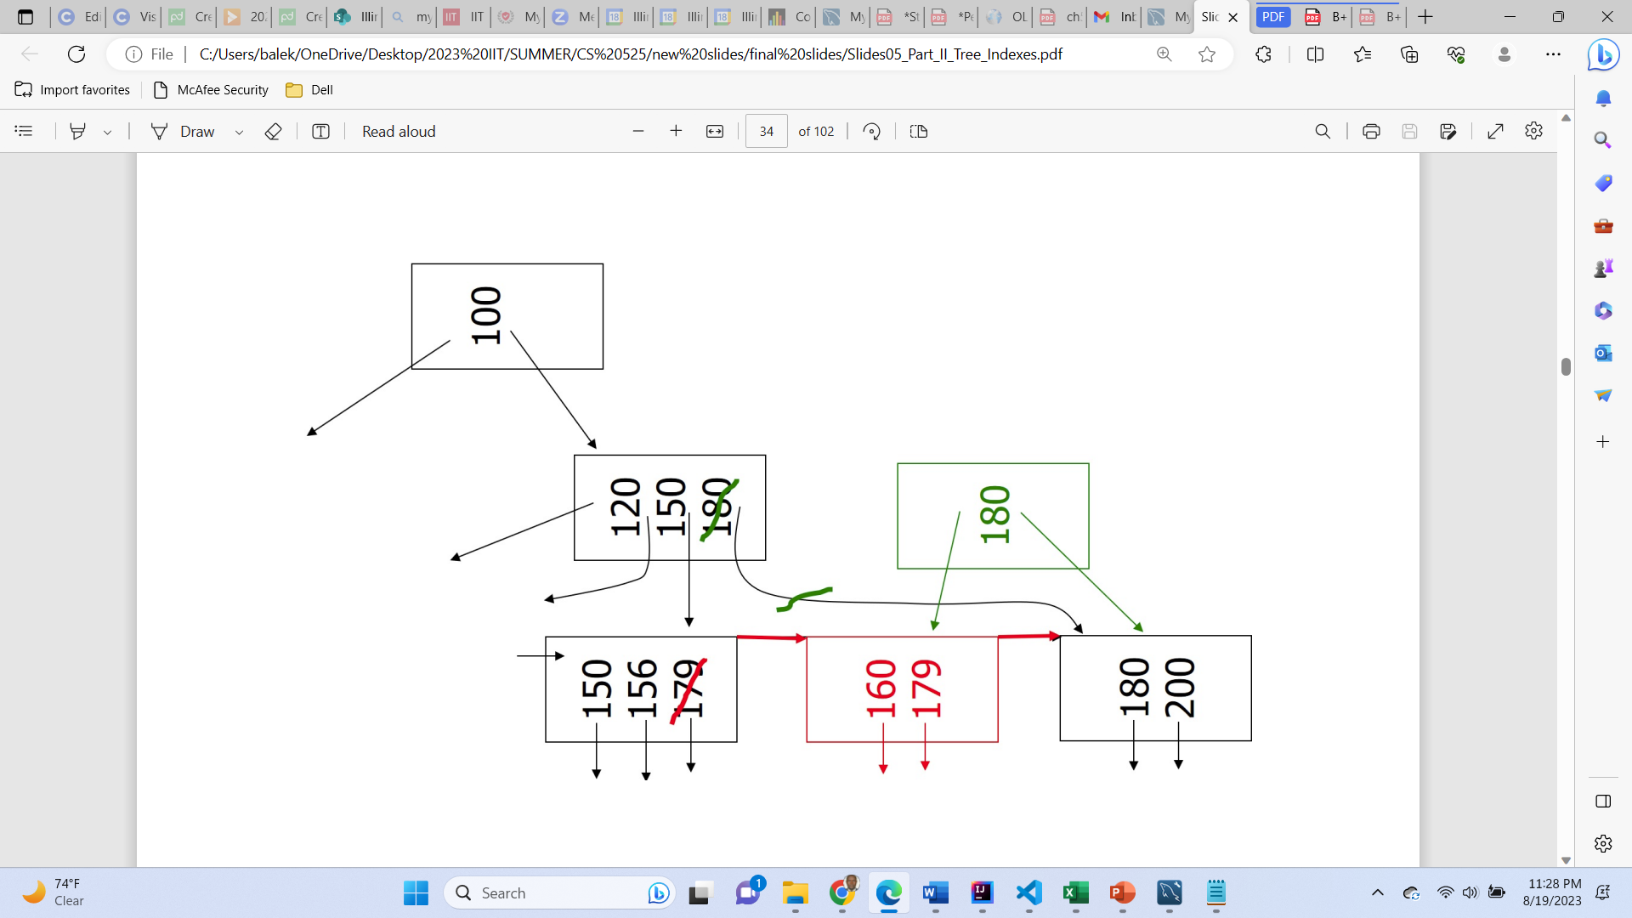
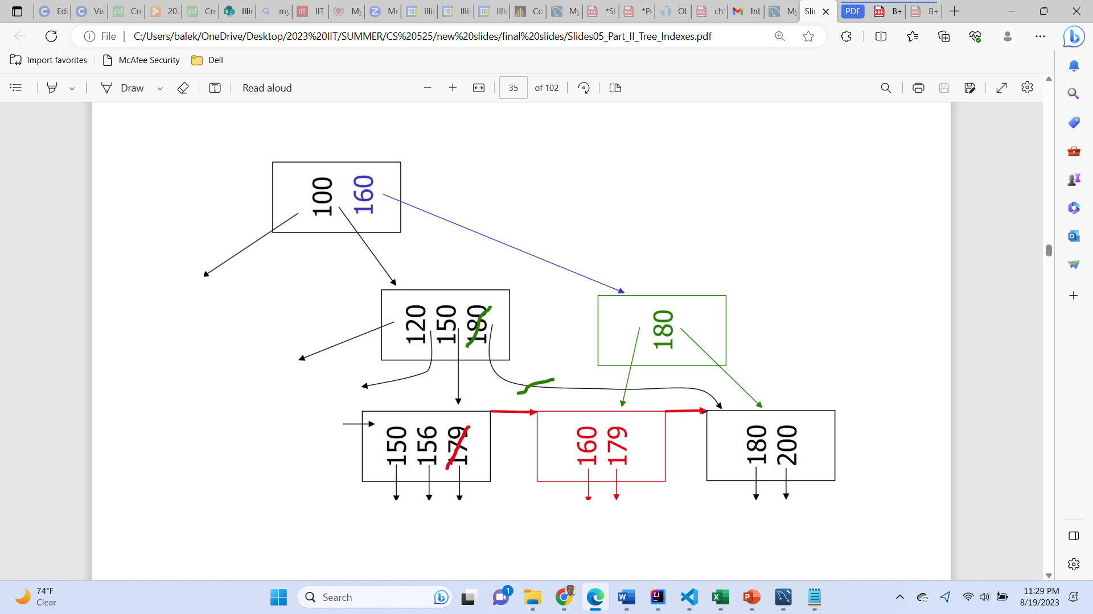
Case: Non-leaf overflow - insert into B+ tree
Insert key = 160, n=3
Notes:
A hash function is a mathematical function that converts input data into a fixed-size string of characters, typically for data verification or indexing purposes.

Slide 25
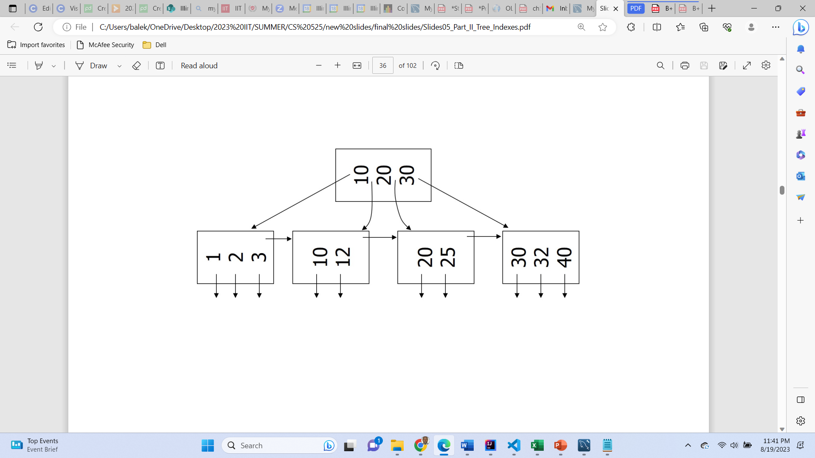
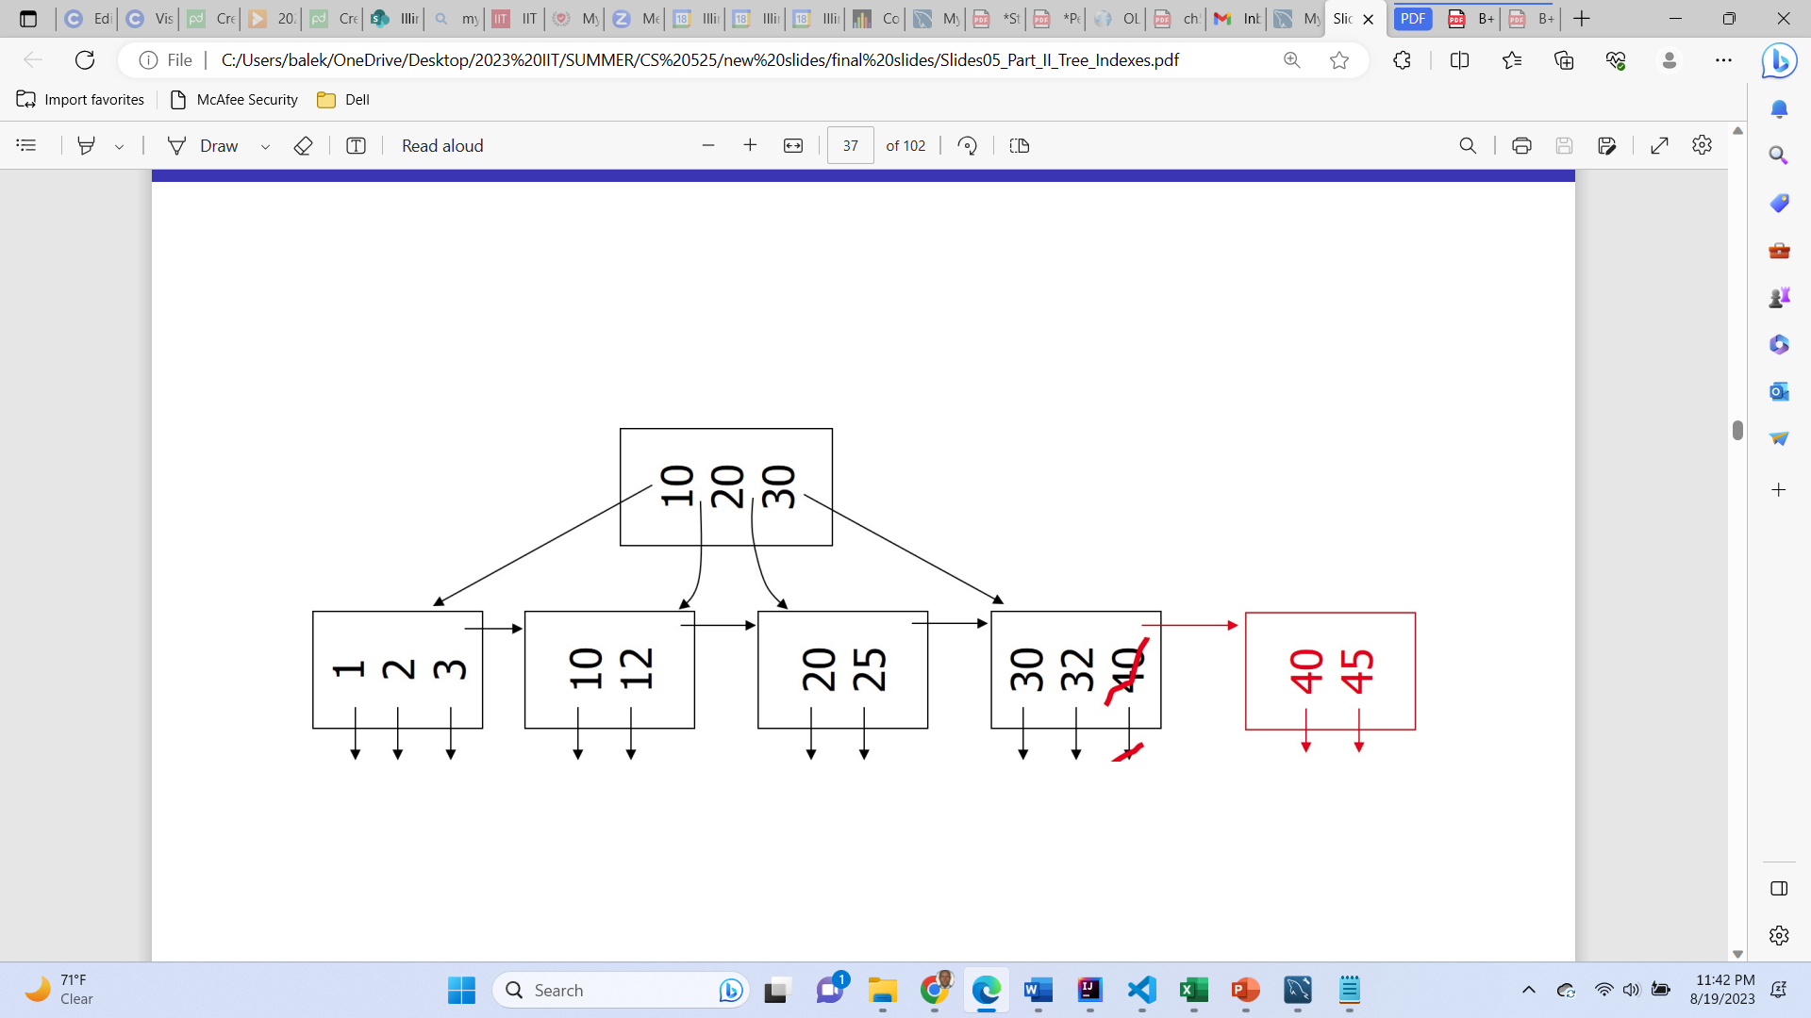
Case: New root - insert into B+ tree
Insert key = 45, n=3
Notes:
A hash function is a mathematical function that converts input data into a fixed-size string of characters, typically for data verification or indexing purposes.

Slide 26
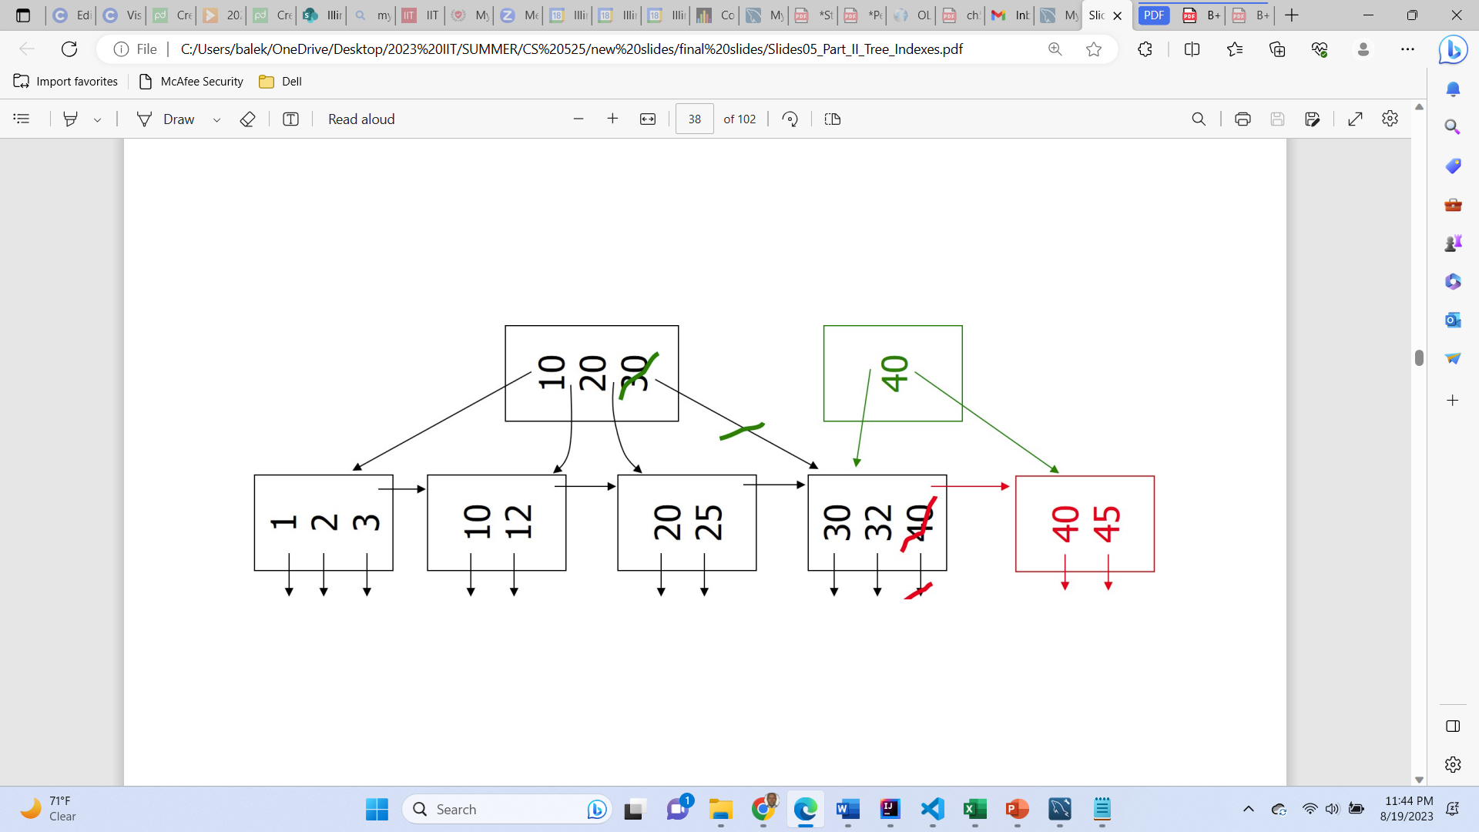
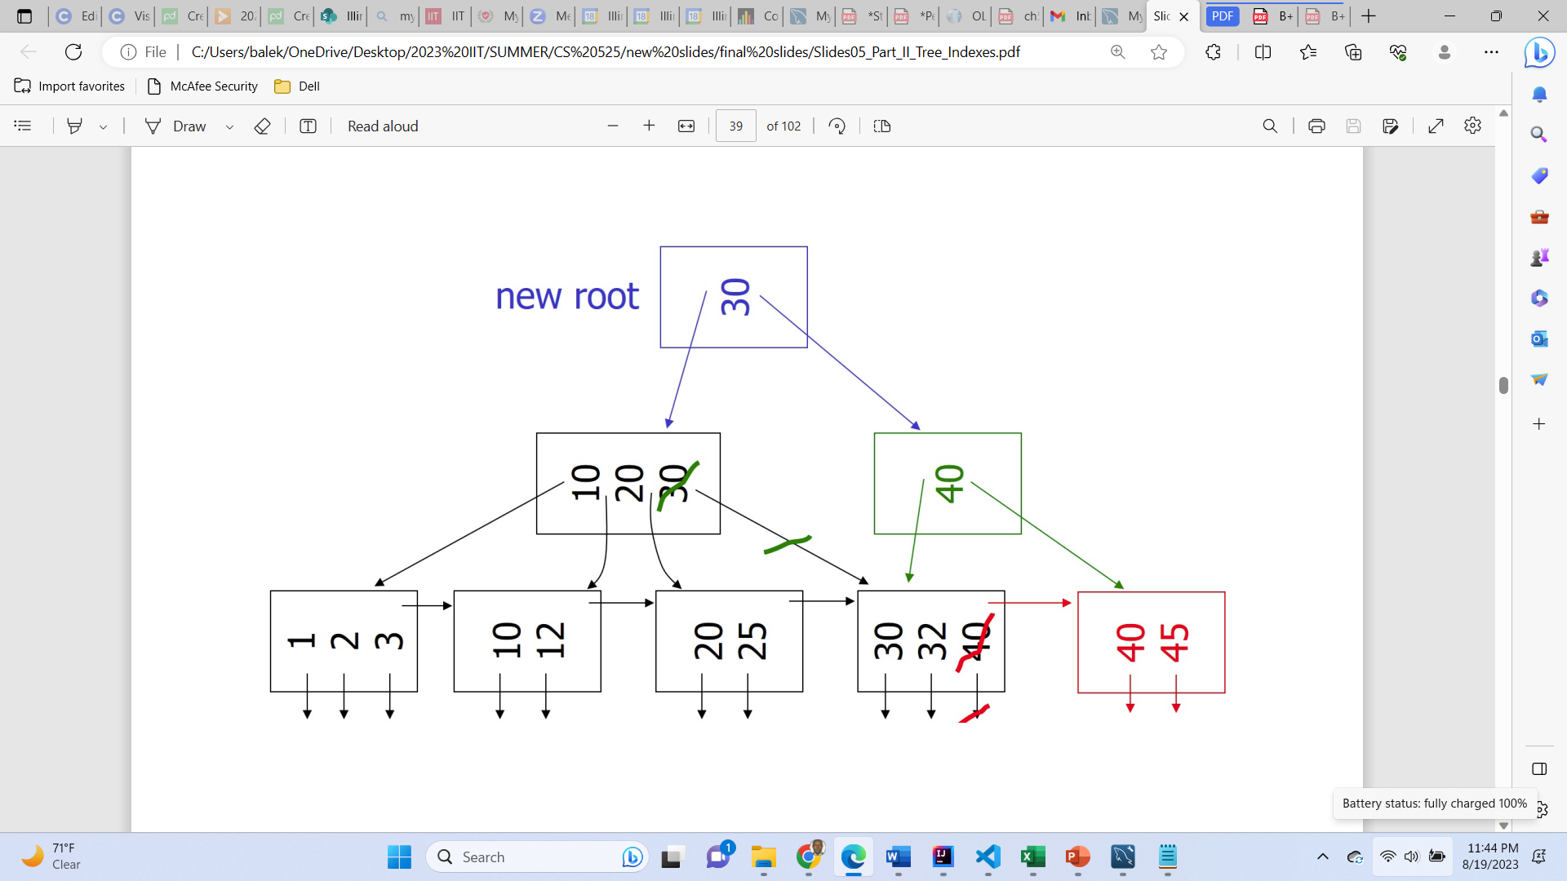
Case: New root - insert into B+ tree
Insert key = 45, n=3
Notes:
A hash function is a mathematical function that converts input data into a fixed-size string of characters, typically for data verification or indexing purposes.

Slide 27
B+ tree deletion

Slide 28
Deletion algorithm
To Delete record with key k
Find correct leaf L.
Remove the entry:
If L is at least half full, the operation is done.
Otherwise
You can try to redistribute, borrowing from sibling.
If redistribution fails, merge L and sibling.
If merge occurred, you must delete entry in parent pointing to L.
Note
B+-Tree removes a key from a leaf node but not necessary from the non-leaf/inner nodes.
Notes:
A hash function is a mathematical function that converts input data into a fixed-size string of characters, typically for data verification or indexing purposes.

Slide 29
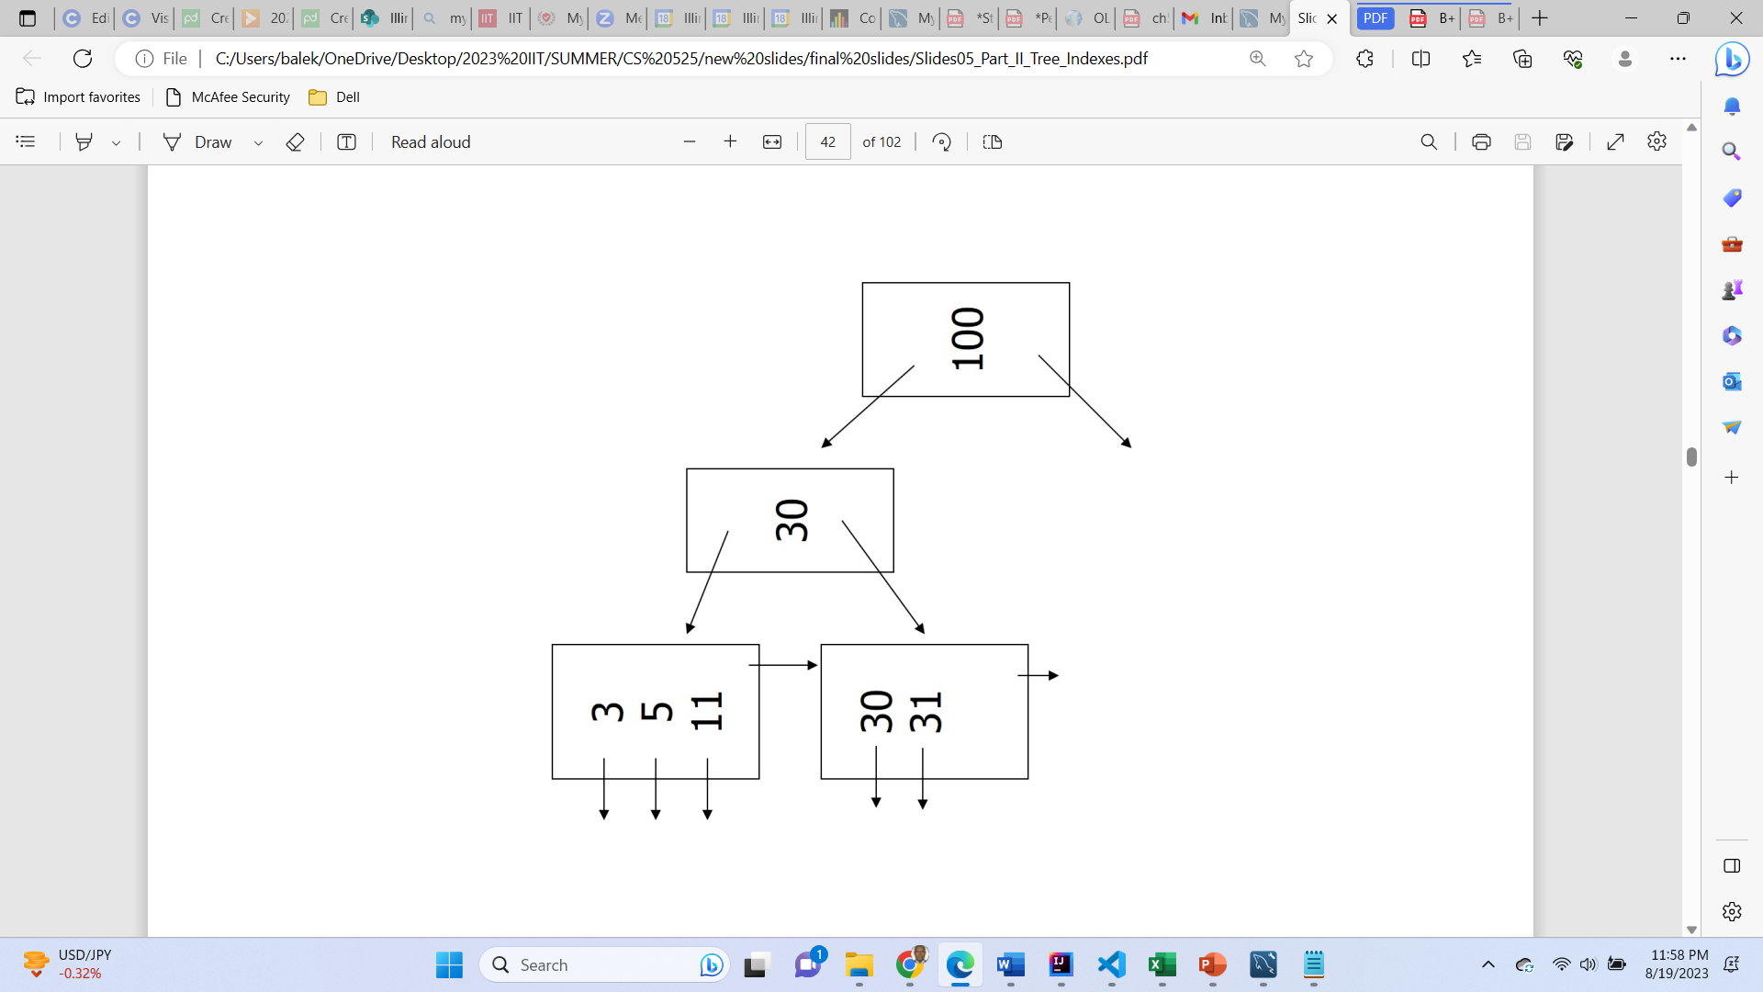
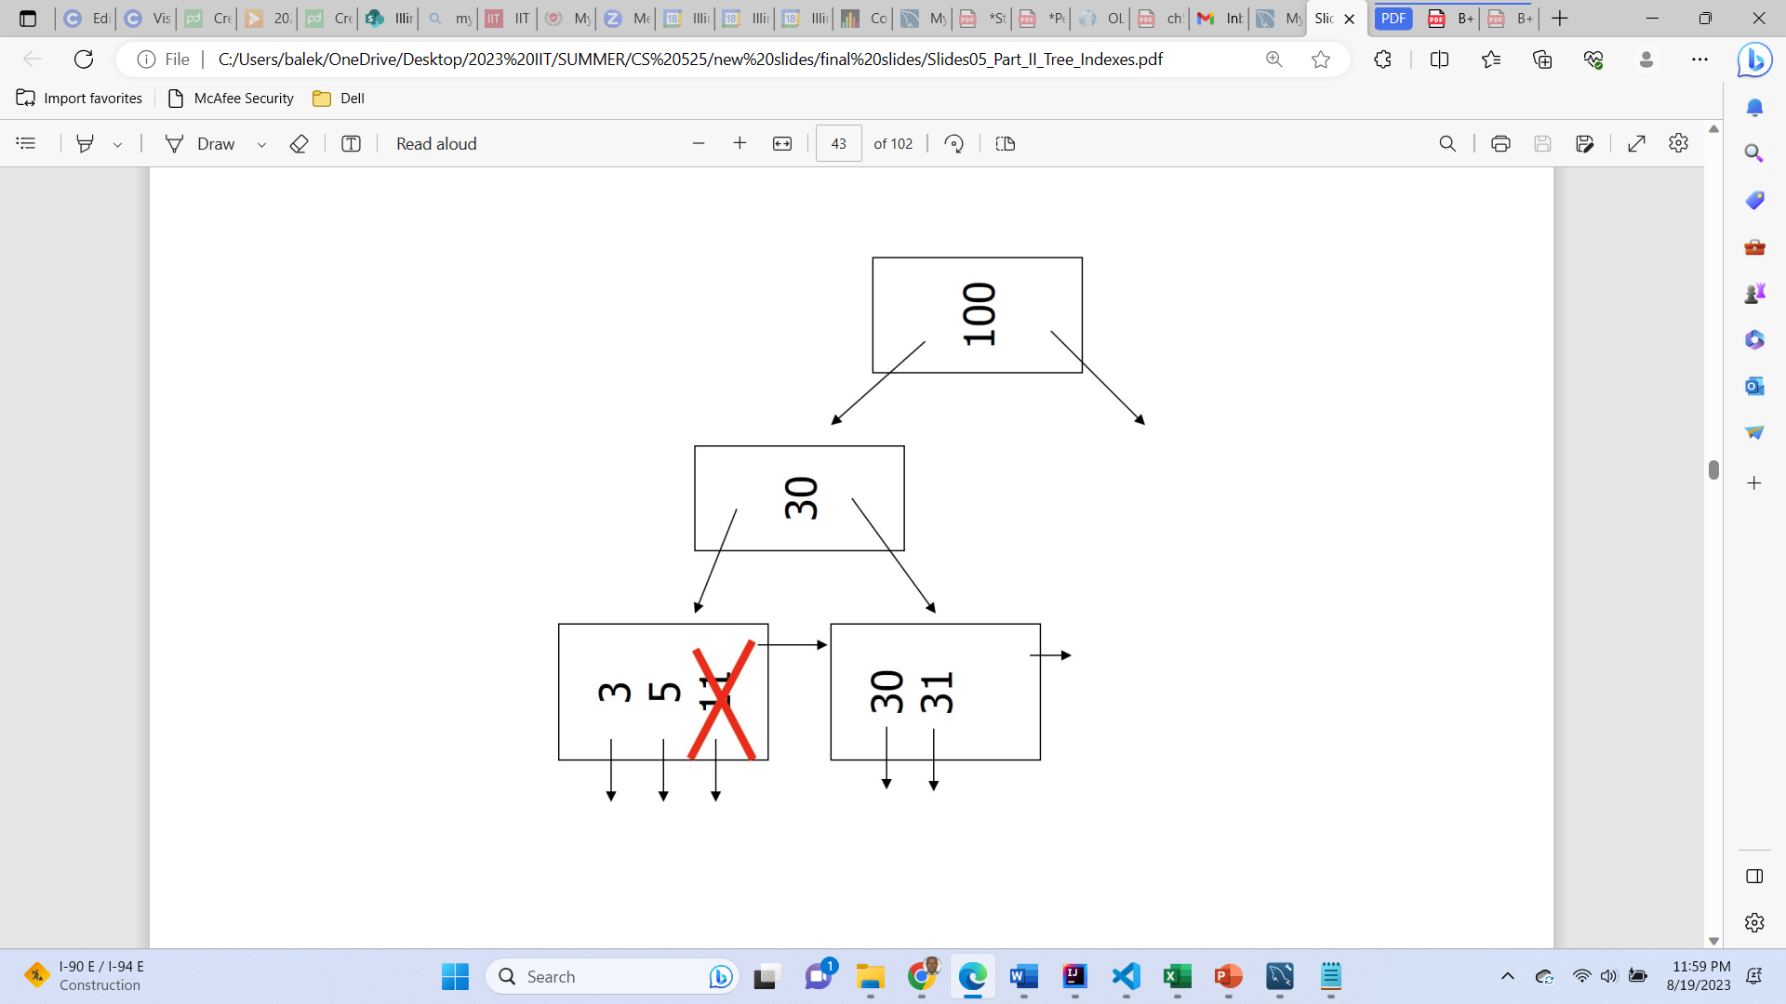
Case: simple delete from B+ tree
delete key = 11, n=3
Notes:
A hash function is a mathematical function that converts input data into a fixed-size string of characters, typically for data verification or indexing purposes.

Slide 30
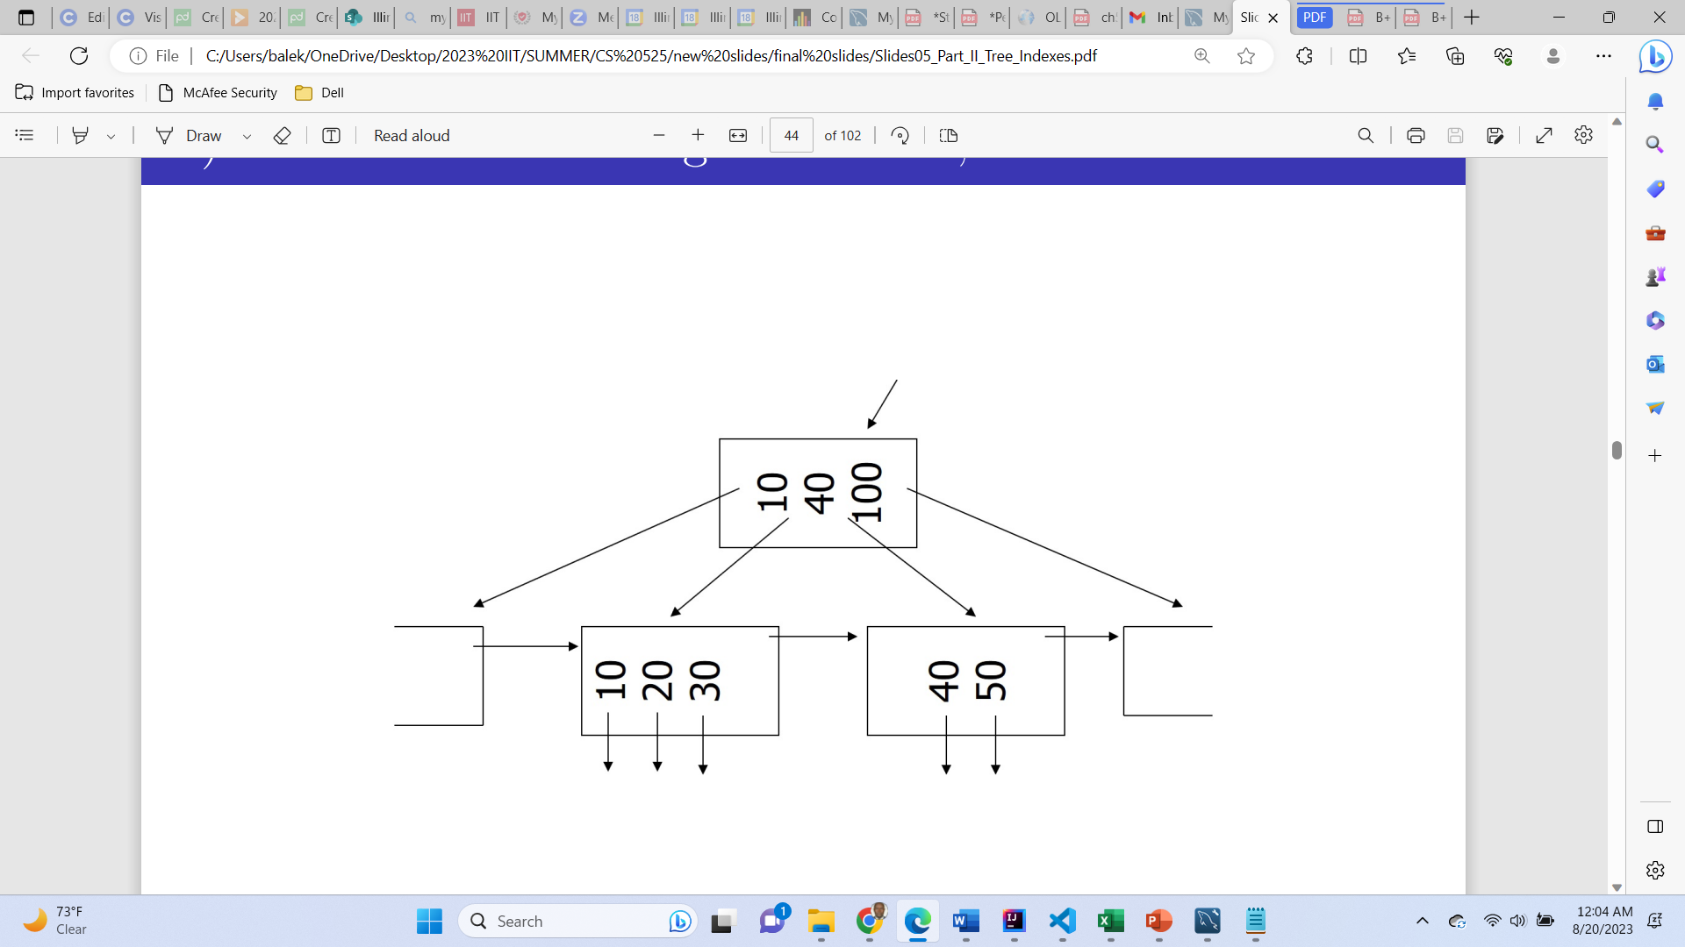
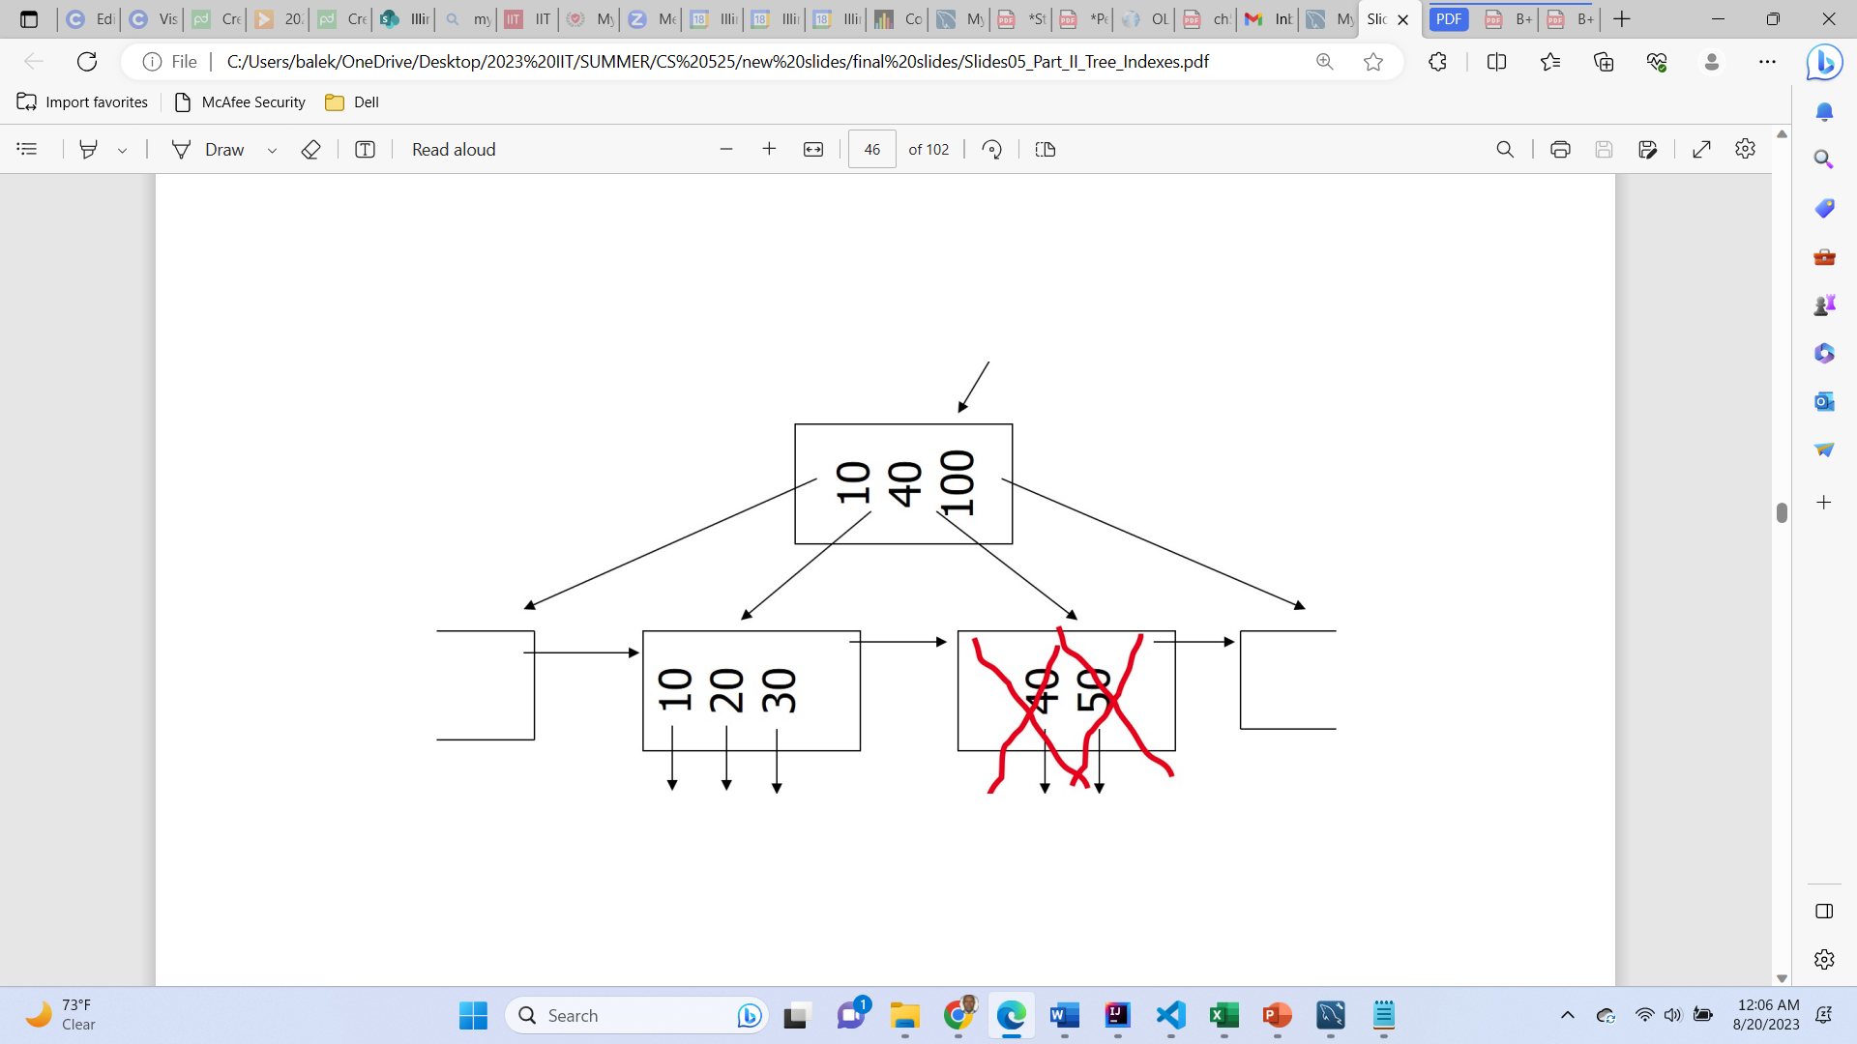
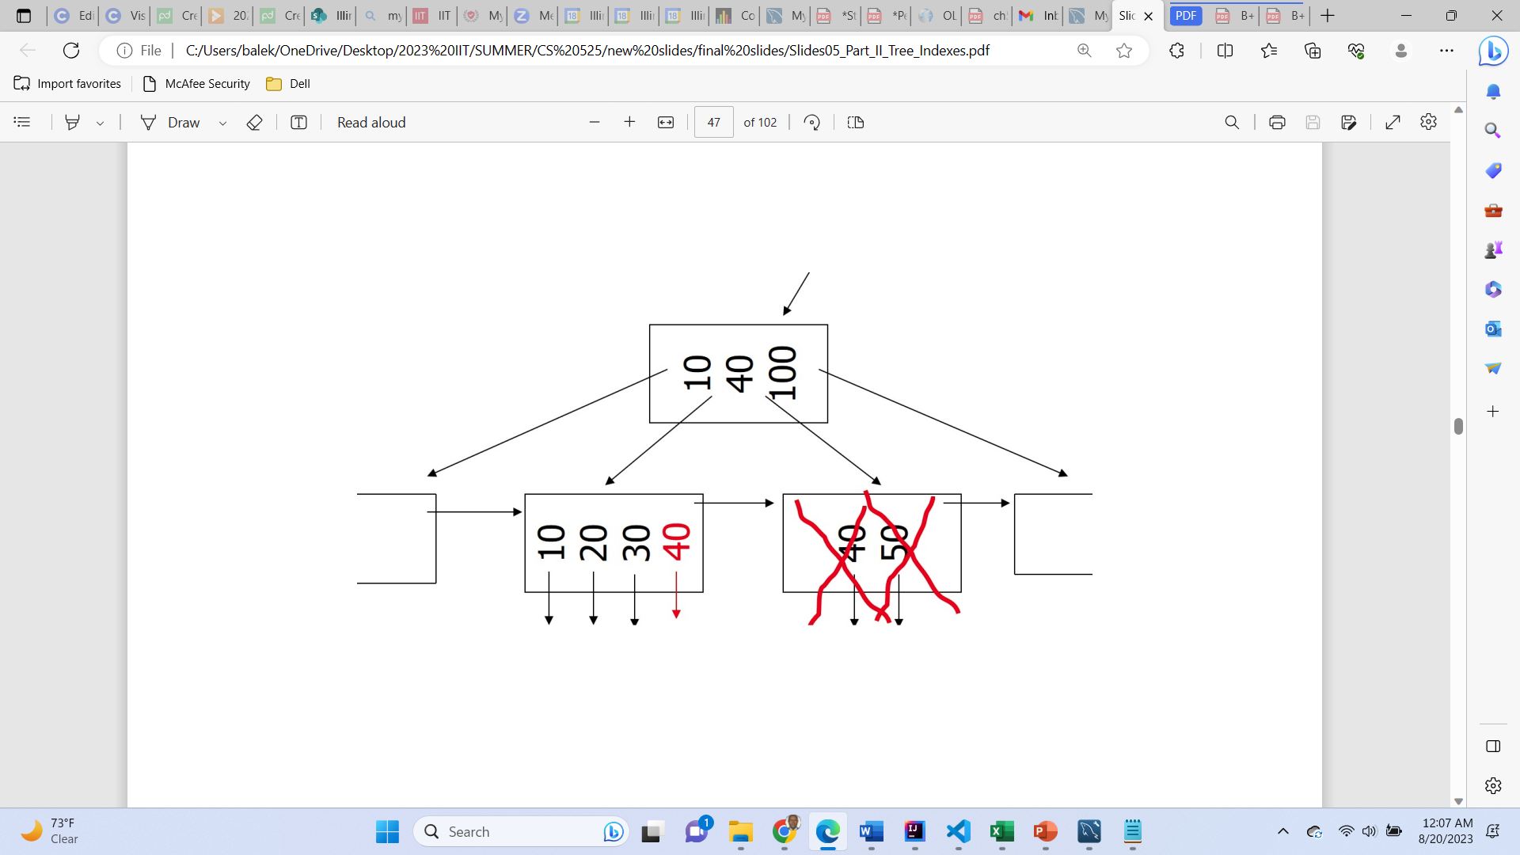
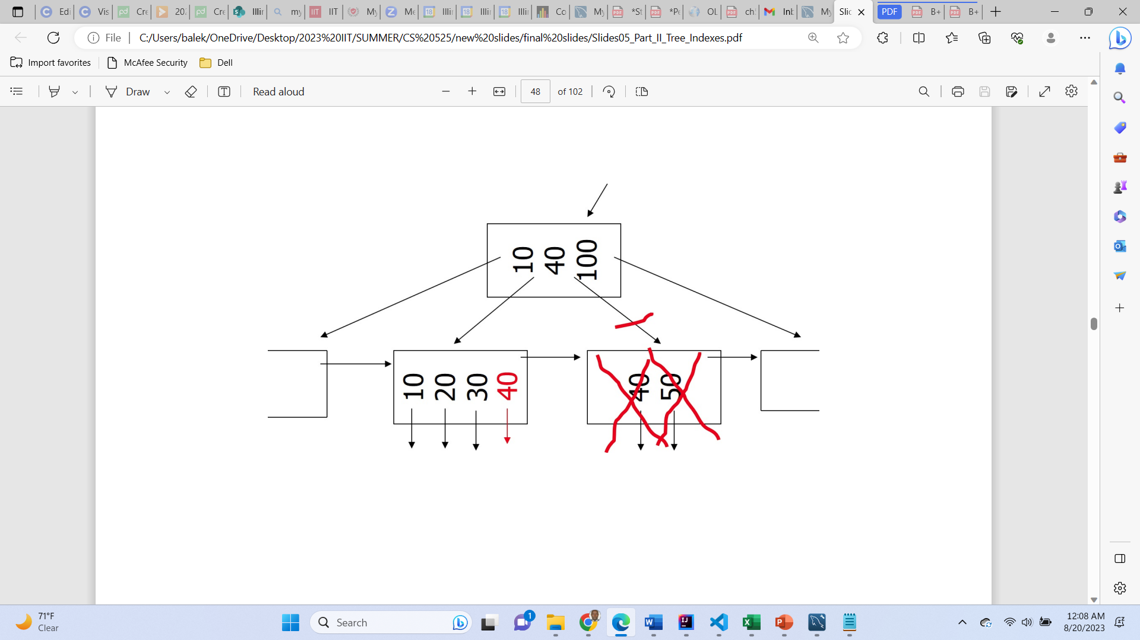
Case: coalesce with sibling
delete key = 50, n=4
Notes:
A hash function is a mathematical function that converts input data into a fixed-size string of characters, typically for data verification or indexing purposes.

Slide 31
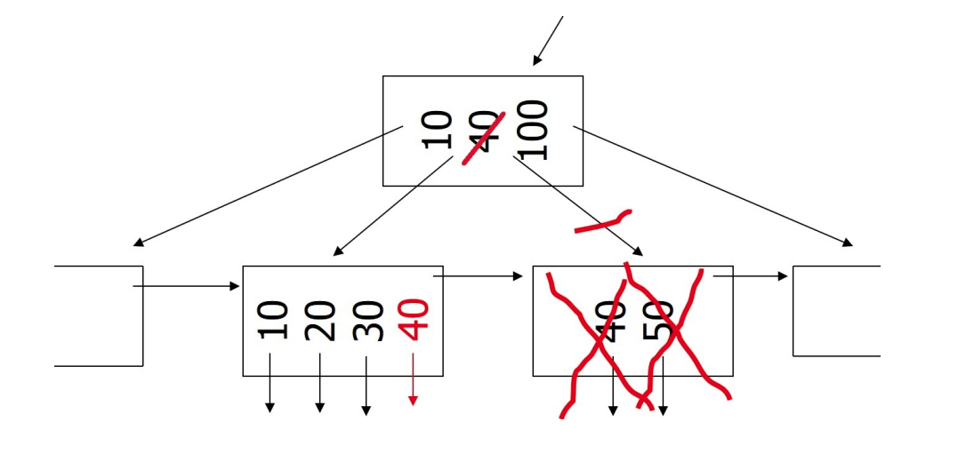
Case: coalesce with sibling
delete key = 50, n=4
Notes:
A hash function is a mathematical function that converts input data into a fixed-size string of characters, typically for data verification or indexing purposes.

Slide 32
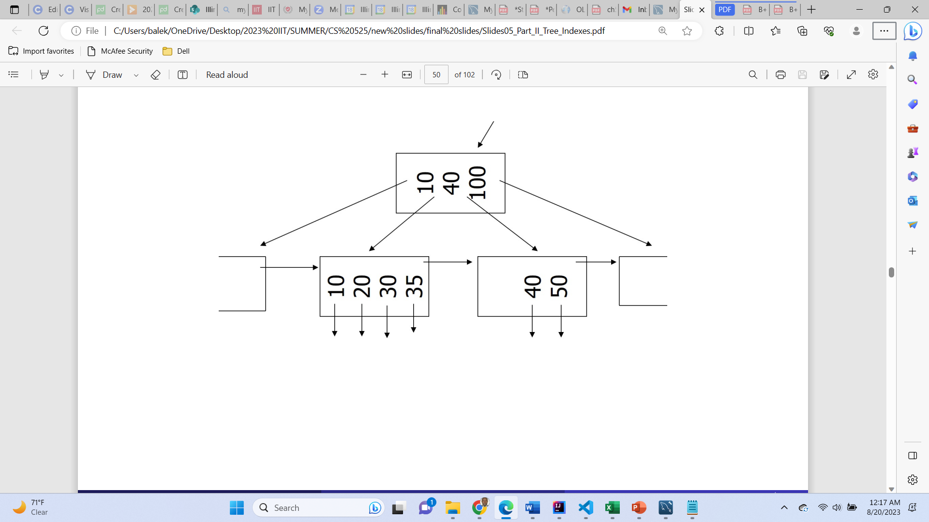
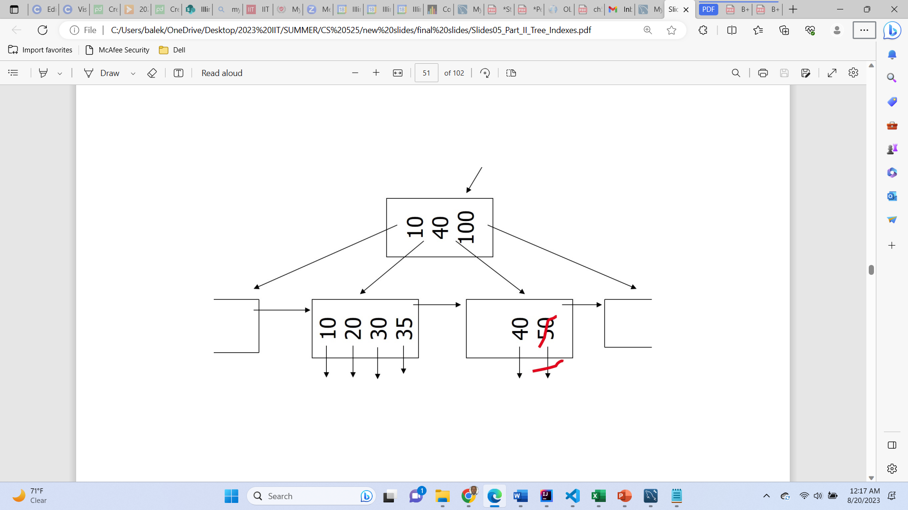
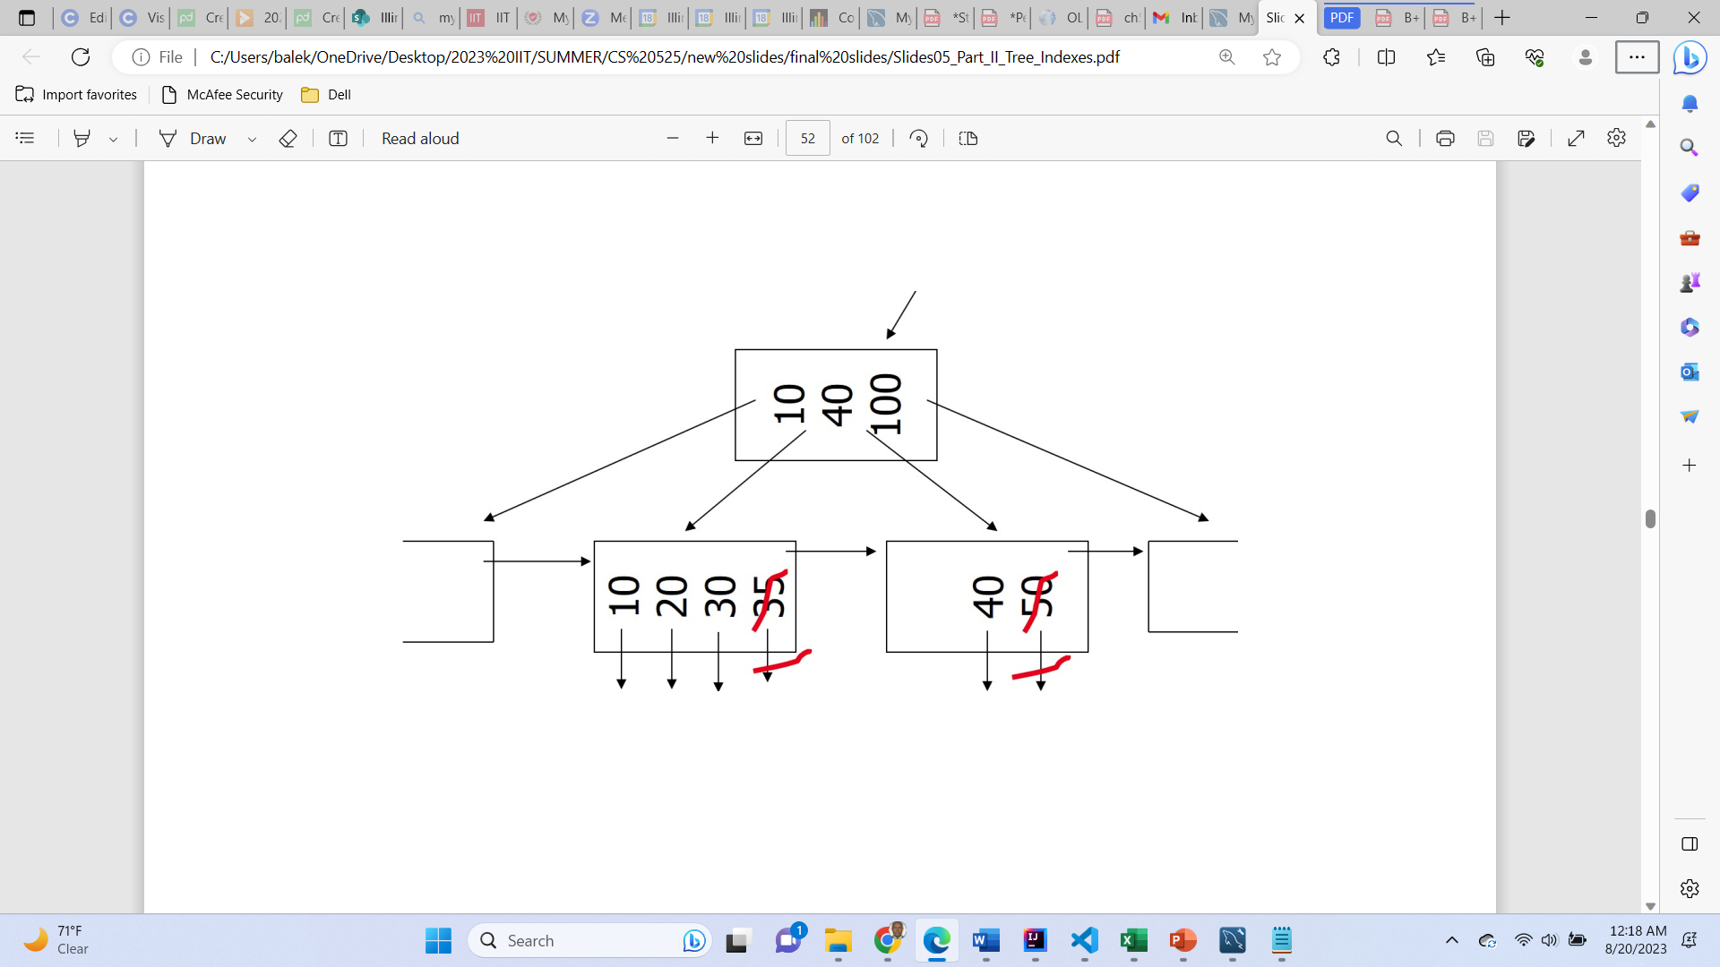
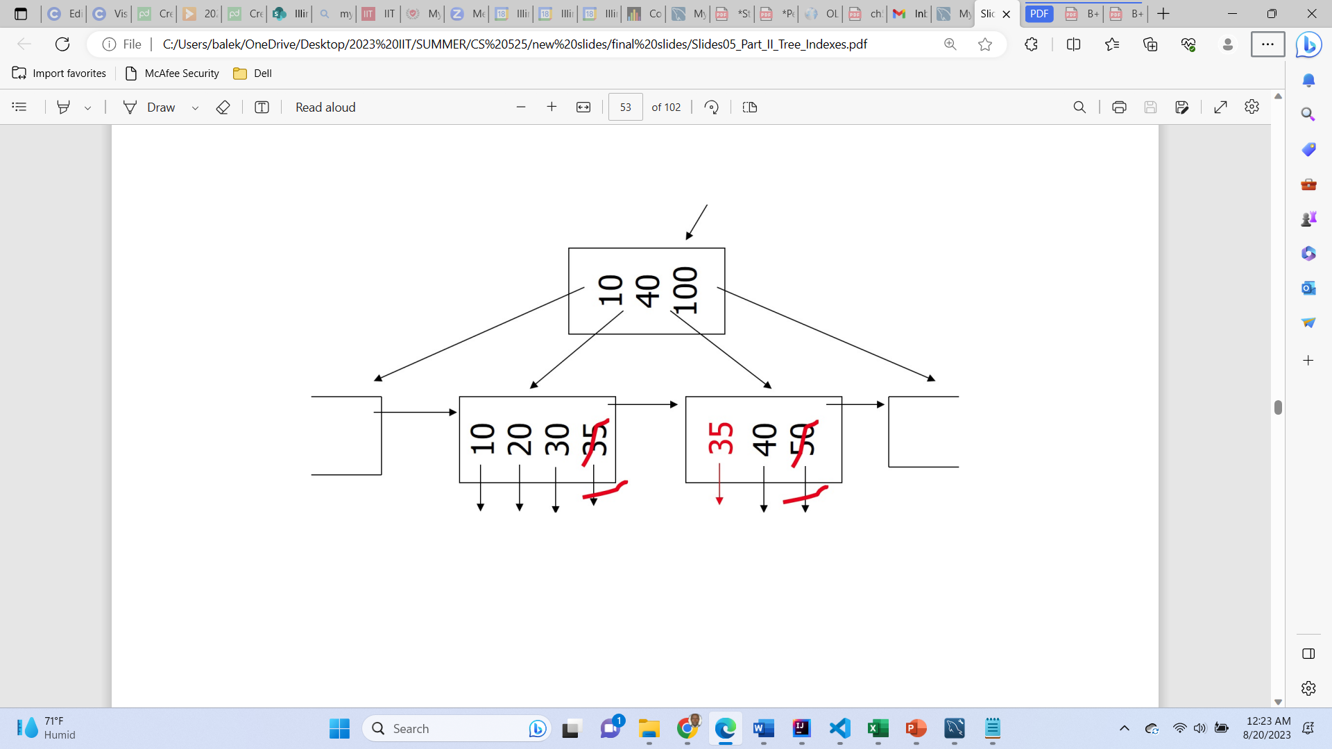
Case: redistribute keys
delete key = 50, n=4
Notes:
A hash function is a mathematical function that converts input data into a fixed-size string of characters, typically for data verification or indexing purposes.

Slide 33
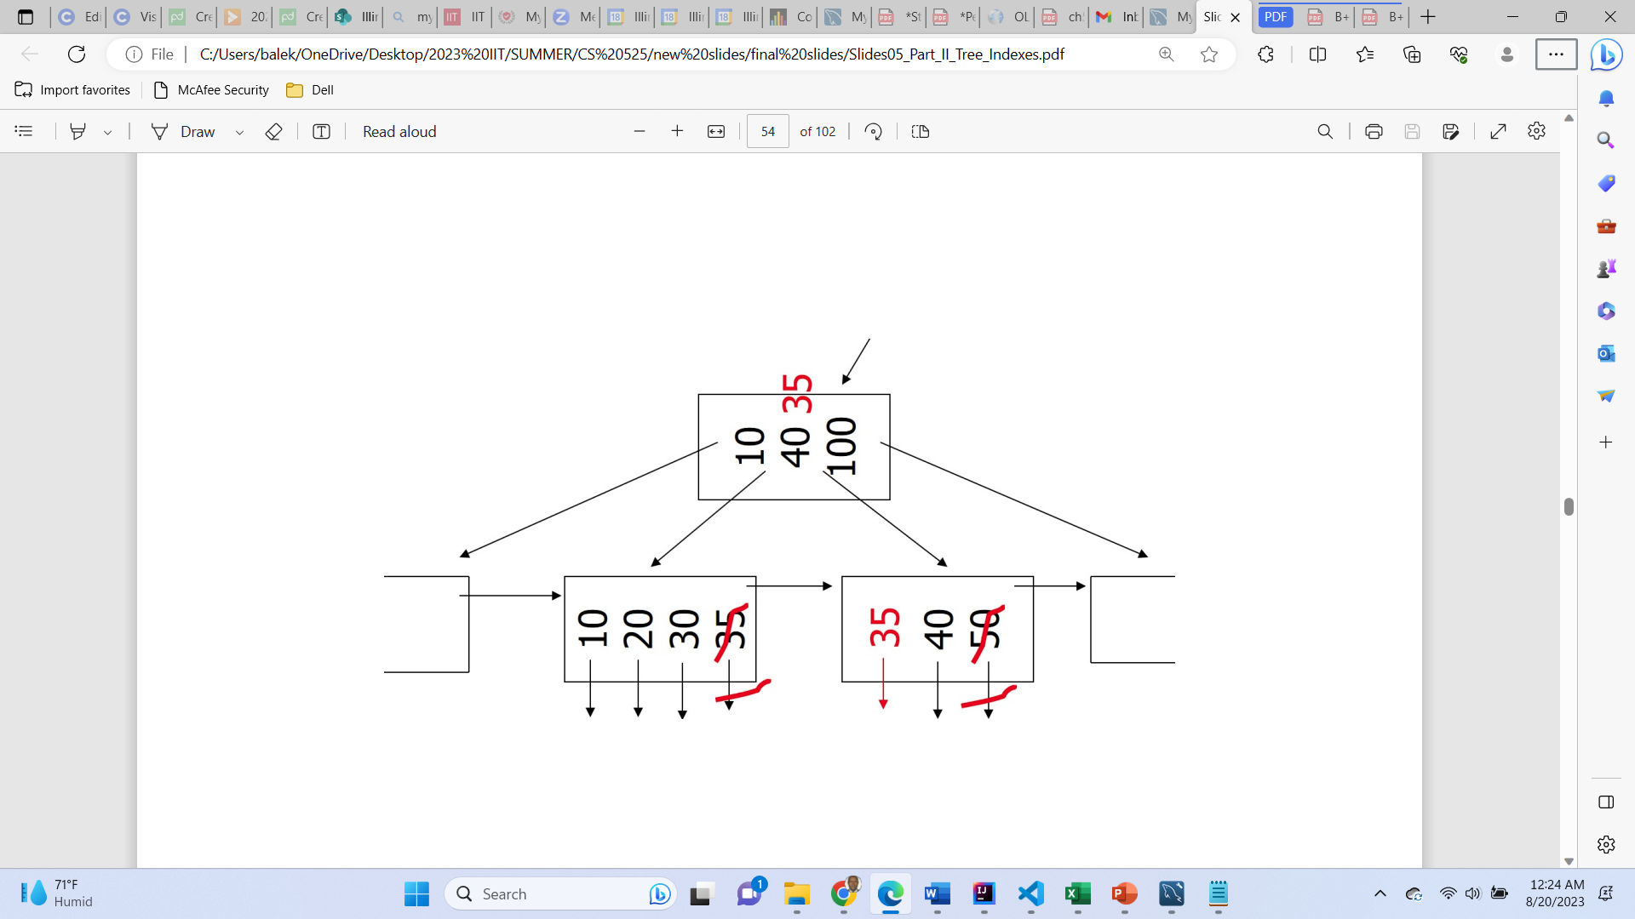
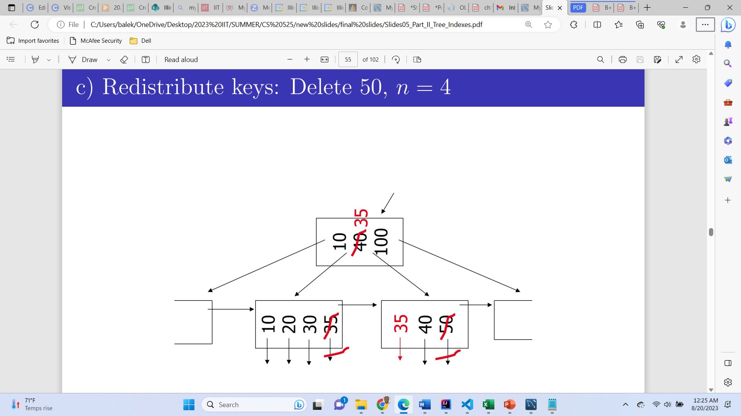
Case: redistribute keys
delete key = 50, n=4
Notes:
A hash function is a mathematical function that converts input data into a fixed-size string of characters, typically for data verification or indexing purposes.

Slide 34
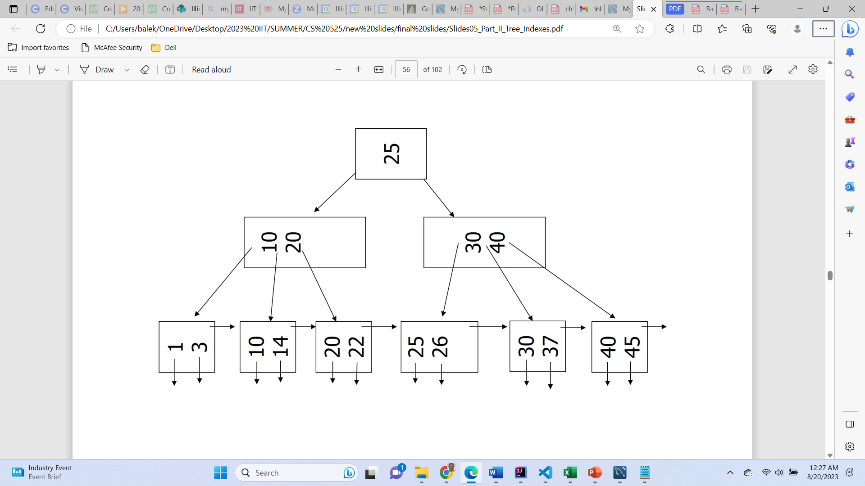
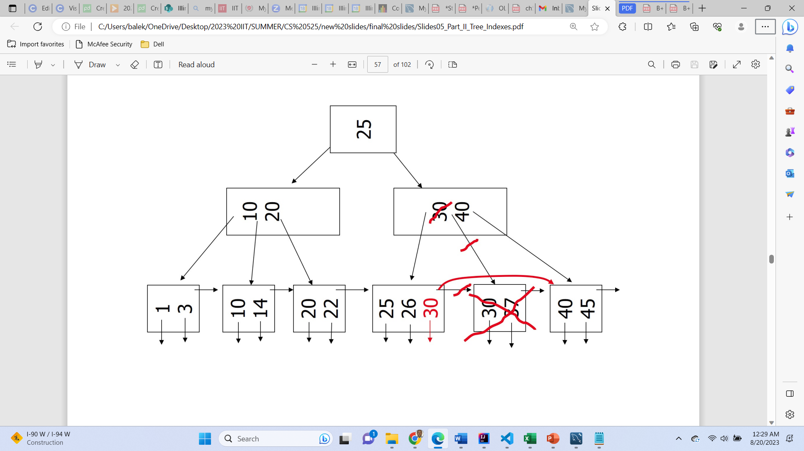
Case: Non-leaf coalesce
delete key = 37, n=4
Notes:
A hash function is a mathematical function that converts input data into a fixed-size string of characters, typically for data verification or indexing purposes.

Slide 35
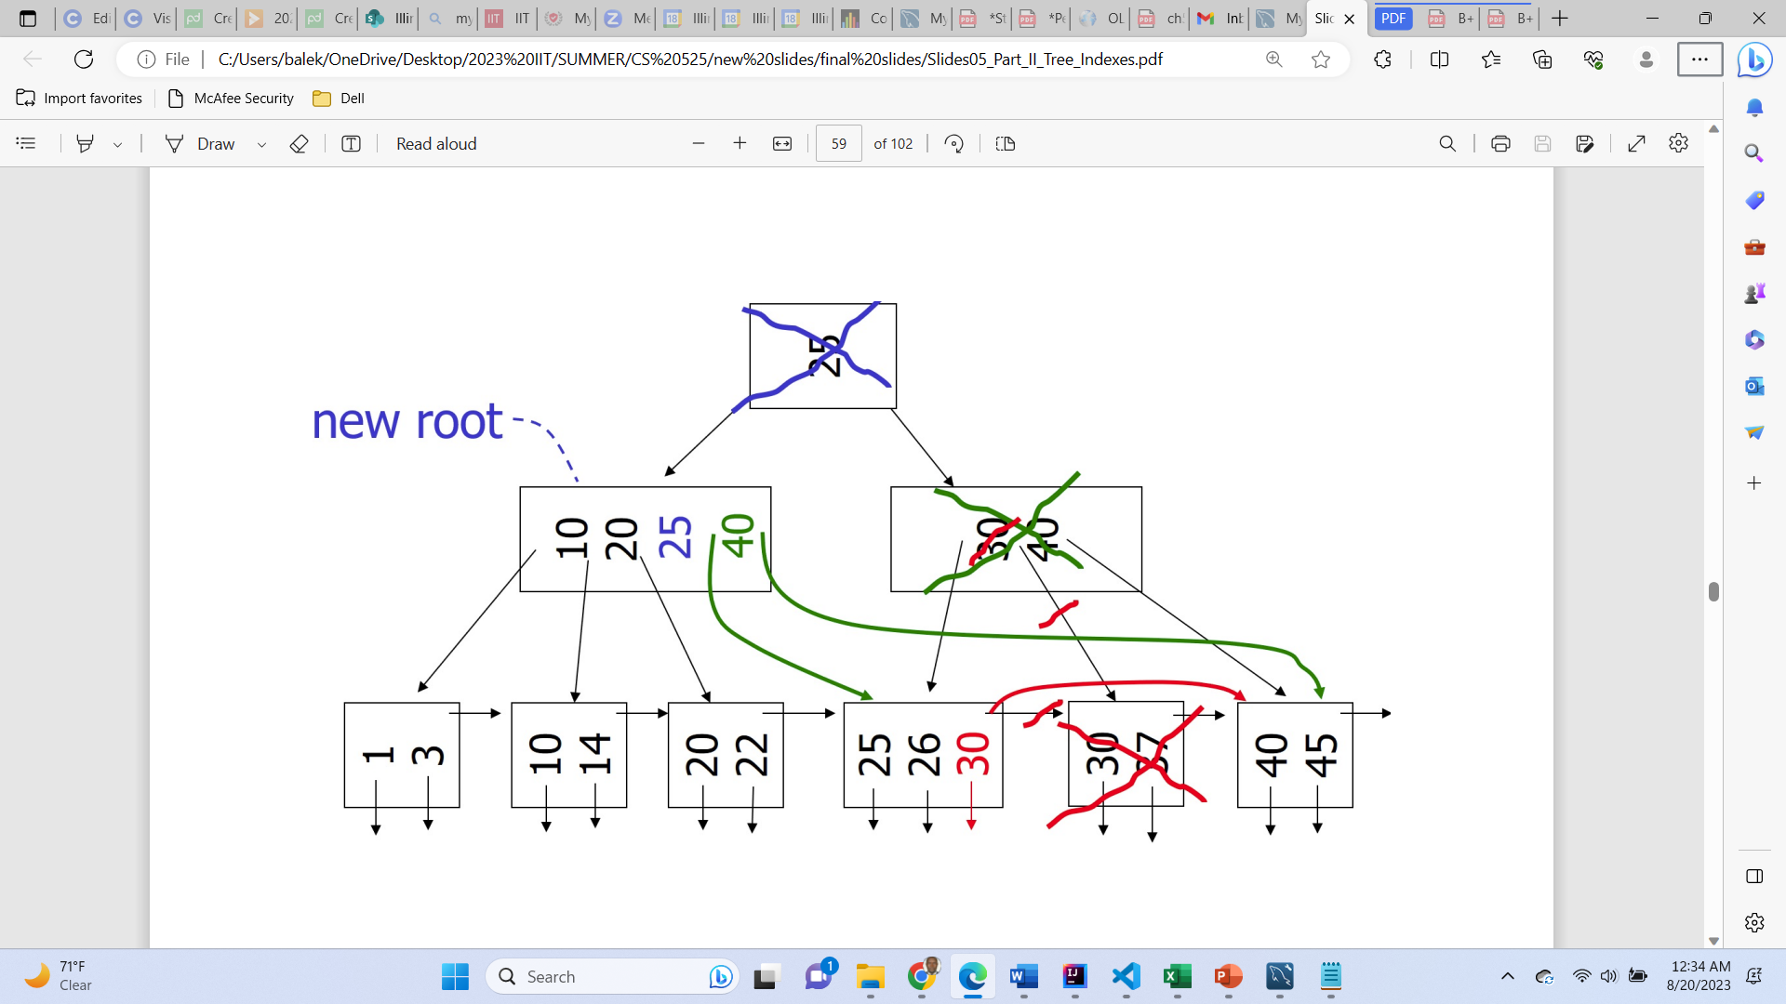
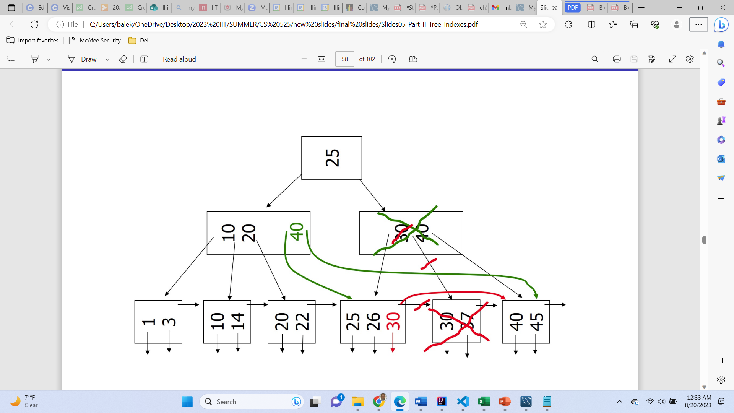
Case: Non-leaf coalesce
delete key = 37, n=4
Notes:
A hash function is a mathematical function that converts input data into a fixed-size string of characters, typically for data verification or indexing purposes.

Slide 36

Hashing

Slide 37
Basic concepts: Static hashing
In hash file organization, records are stored in units known as buckets. A bucket is determined by the hash function using a search key.
Hash function h is a function from the set of all search-key values K to the set of all bucket addresses B. i.e., h(k) = K modulo B.
Ideal hash function is uniform, i.e., each bucket is assigned the same number of search-key values from the set of all possible values.
ideal hash function is random, so each bucket will have the same number of records assigned to it irrespective of the actual distribution of search-key values in the file.
Hash function is used to locate records for access, insertion as well as deletion.
Records with different search-key values may be mapped to the same bucket, thus entire bucket has to be searched sequentially to locate a record.

Slide 38
Example: Hash File Organization
Suppose: Hash file organization of student file, using SID as key: Assume 4 buckets (B=4)
Search keys, K,(SID in student)
Hash (25) = 1 Hash (55) = 2 Hash (23) = 3 Hash (27) = 3
If search key is a string:
the binary representations of all the characters in the string could be added and the sum modulo the number of buckets could be returned.
bucket 0
24 | John | MIT | 4.9
44 | Ros | MIT | 2.9
bucket 1
25 | Tomas | Uchi | 4
33 | Simon | UIC | 2.8
77 | SaraDoe | UCLA | 4.7
bucket 2
55 | Keet | UCT | 3.3
bucket 3
23 | Michelle | IIT | 3.5
27 | Biden | IIT | 3.8

Slide 39
Bucket Overflows
Buckets may overflow due to:
Insufficient buckets (fewer buckets)
multiple records have same search-key value
hash function produces non-uniform distribution of key values
Overflow buckets of a given bucket is known as overflow chaining, also chained to form a linked list
This scheme is called closed hashing – which used overflow buckets schema.
NB: the probability of bucket overflow can be reduced, but itself not eliminated
`
Bucket 0
Bucket 1
Bucket 2
Overflow Bucket
Bucket 3
Overflow Bucket
Overflow Bucket

Slide 40
Hash Indexing
Hashing can be used also for index-structure creation.
A hash index organizes the search keys, with their associated record pointers, into a hash file structure.
Hash indices are viewed as secondary indices:
If the file itself is organized using hashing, thus no need of a separate primary hash index.
However, the term hash index is used to refer to both secondary index structures and hash organized files.
bucket 0
24
44
bucket 1
25
33
23 | Michelle | IIT | 3.5
24 | John | MIT | 4.9
33 | Simon | UIC | 2.8
55 | Keet | UCT | 3.3
25 | Tomas | UChi | 4
44 | Ros | MIT | 2.9
27 | Biden | IIT | 3.8
bucket 2
55
Student (SID, Sname, Uni, GPA)
bucket 3
23
27
Hash index on SID
Hash File stores <SID, pointer>

Slide 41
Drawbacks of Static Hashing
In static hashing, hash function maps search-key values to a fixed set of B of bucket addresses.
What if the database grows or shrinks?
If initial number of buckets is too small, and file grows, database performance will be affected due to too much overflows.
If space is allocated for anticipated growth, a significant amount of space will be wasted initially (and buckets will be under capacity).
If database shrinks, again space will be wasted.
Solution(s):
periodic re-organization of the file with a new hash function (although expensive, disrupts normal operations)
allow the number of buckets to be modified dynamically.

Slide 42
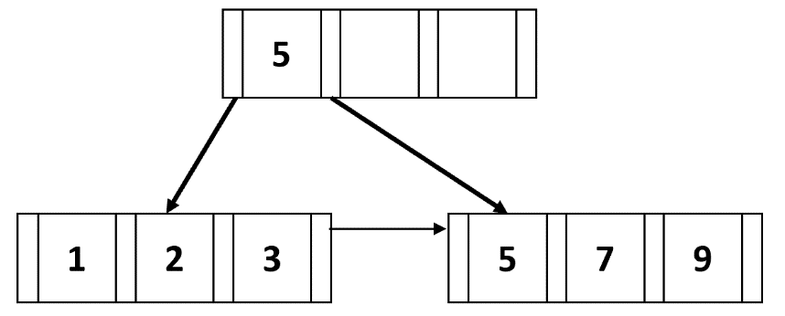
Practice Activity: B+ tree insertion & deletion
Suppose each B+-tree node can hold up to four (4) pointers and three (3) keys. Draw the B+-trees that would result after insertion (A) and deletion (B) operations [show individual trees after each deletion or insertion].
A) Insertion: First, insert 4. Then, insert 6. Next, insert 8. Finally, insert 10.

Slide 43
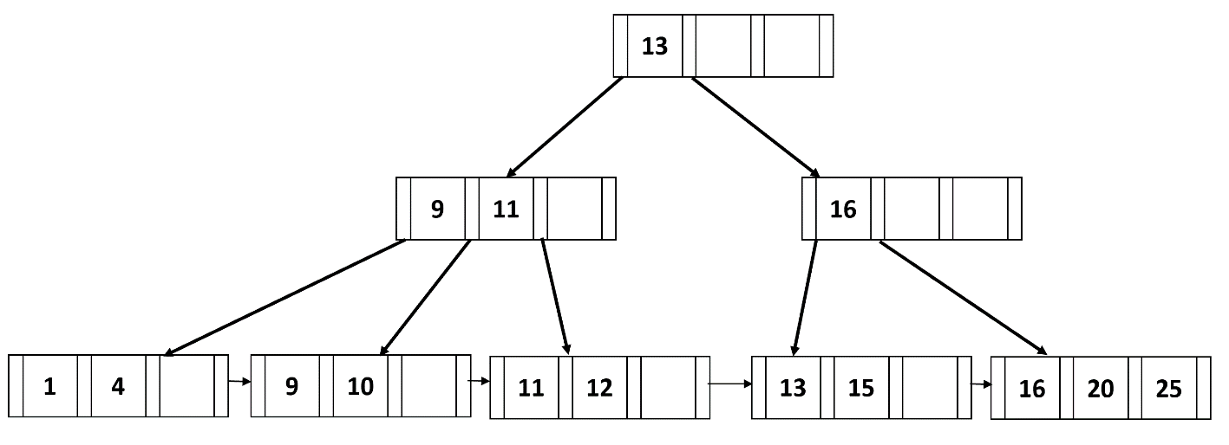
Practice Activity: B+ tree insertion & deletion …cont’d
B) Deletion: First, delete 13. Then, delete 15. Finally, delete 1.

Slide 44
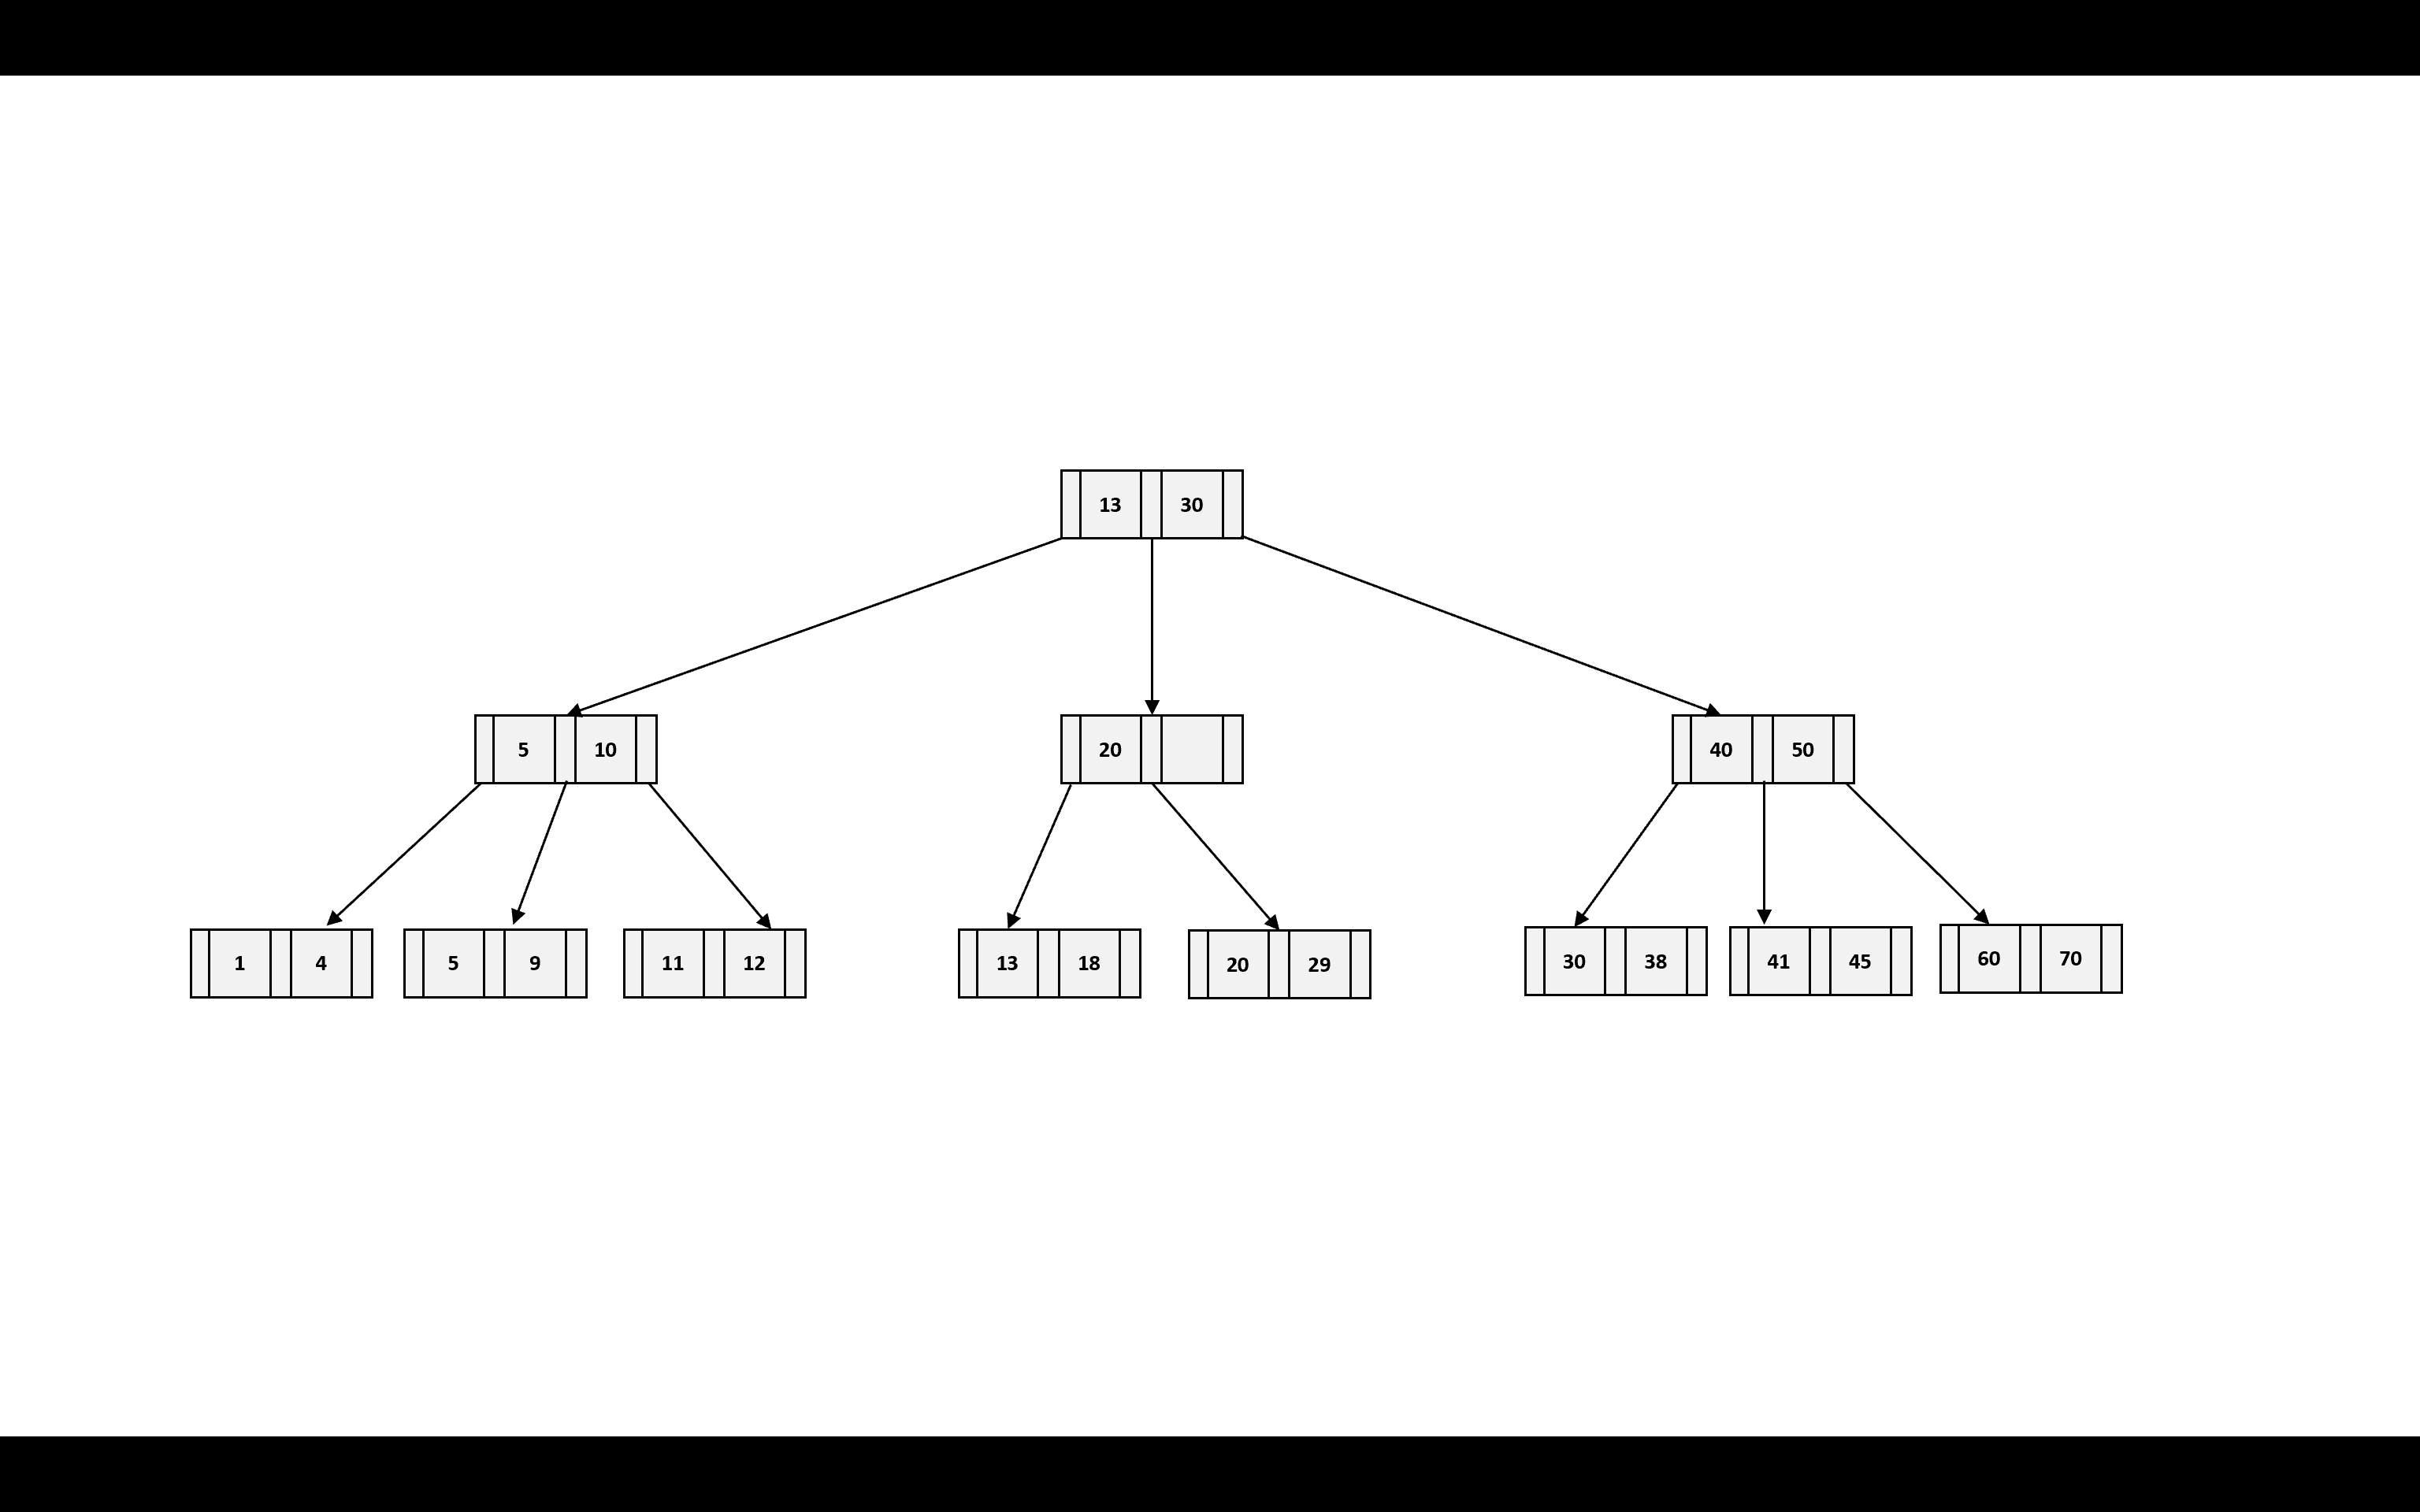
Assessment Activity 5: B+ tree insertion & deletion
Suppose each B+-tree node can hold up to 3 (three) pointers and two (2) keys. Draw the B+-trees that would result after insertion (a) and deletion (b) operations as shown below
(a) Insertion
First, insert 19. Then, insert 27 [Show individual trees at each insertion].
(b) Deletion: Use the tree after inserting 27:
First, delete 5; then delete 9; next, delete 12; after that, delete 4; and finally, delete 11

Slide 45
Summary
Indexing mechanism
Primary and secondary
Multilevel indexing
B+ tree indexing
Insertion
Deletion
Hashing and hash index
Activities:
Practice: B+ tree operations
Assessment 5: B+ tree insertion and deletion operations

Slide 46
References
Silberschatz, A., Korth, H. F., & Sudarshan, S. (2020). Database system concepts (Seventh edition). McGraw-Hill.

